Slide 1
Foundation Certificate in Business Analysis v3.2

Slide 2
Administration
Safety
Breaks/meals
Room/s
Security
Course times

Slide 3

Course Materials
Pre-course reading
BCS Business Analysis Book (3rd edition, 2014)
Delegate Manual (A5) containing the slide deck
Delegate Exercise and Revision Workbook (A4)
Notes:
This manual is different to courses such as MBP, BAP etc as we have the BCS book…
Rather than duplicate content across the courseware and BCS book we have chosen to replicate the slides in the book and provide some notes and space for note-taking on each page.
Each slide also references the BCS book so that delegates can follow the book if they wish.
Make sure you note the importance of the delegates taking responsibility for their own revision! We can guide them through the content and give them revision techniques but they will need to do the rest. The delegate revision workbook can help.

Slide 4
Delegate Manual and Exercise/Revision Workbook
Delegate Manual
The manual has been specifically designed to provide consolidated information that will help you understand the key topic areas and revise for the exam
Exercise and Revision Workbook
Section One
Exercises and Solutions
Homework
Multiple Choice Quizzes (day 1 and day 2)
Practice Exam Paper
Section Two
Questions based on the textbook – not mandatory
Notes:
The manual has been specifically designed to help delegates through the examination.
This is a closed book exam so delegates should decide now how they will revise.
Note that the course outline no longer states that delegates are expected to complete 2 – 3 hours homework per evening. Instead it says approx. 1 hour. It’s up to the instructor how they manage expectations here.

Slide 5
About You
Name
Company
Role and key responsibilities
Knowledge of Business Analysis
Your objectives for attending this course
Other courses – Business Analysis Diploma?
Why am I here?

Slide 6
BCS Certificate Objectives
Holders of the BCS Foundation Certificate in Business Analysis should be able to demonstrate knowledge and understanding of business analysis principles and techniques
Key areas are:
The role and competencies of a business analyst
Strategy analysis
Business system and business process modelling
Stakeholder analysis
Investigation and modelling techniques
Requirements engineering
Business case development

Slide 7
Course Contents
Introduction to Business Analysis
Day 2
Modelling requirements
Exam
Stakeholder analysis and management (cont.)
Day 3
Strategy analysis
Making a business and financial case
Competencies of a Business Analyst
Delivering the business solution
Delivering the requirements
Investigation techniques
Modelling business processes
Documenting and managing requirements
Day 1
Defining the solution
Stakeholder analysis and management
Establishing the requirements
Business analysis process model
Notes:
Note that this may change following the first run

Slide 8
BCS Business Analysis Foundation Exam
Closed book
Multiple choice
40 questions
4 options per question
65% to pass (26/40)
BCS administered
PHOTO ID
60 minutes’ writing time

Slide 9
BCS International Diploma in Business Analysis
BCS International Diploma in Business Analysis
Core | Knowledge-based Specialism | Practitioner Specialism
Business Analysis Practice | Commercial Awareness | Modelling Business Processes
Requirements Engineering | Foundation Certificate in IS Project Management | Systems Modelling Techniques
 | Foundation Certificate in Business Analysis | Systems Development Essentials
 | Foundation Certificate in Business Change | Benefits Management and Business Acceptance
Both of the above + | 1 of the above + | 1 of the above
Notes:
Note that these don’t have to be taken in any order

Slide 10
BCS Diploma - Oral Examination
An oral examination is required to complete the solution development or Business Analysis diploma
Can be booked once all required written exams have been passed
Must be taken within 12 months of the written notification of passing the final exam
2 BCS examiners, 50 minute interview
Questions range over the latest BCS syllabus for the relevant oral exam. Each oral has its own syllabus, and so may cover topics additional to those covered in the written examination modules taken. See http://certifications.bcs.org
Review BCS ‘candidate guidelines’
Review the ‘candidate guidelines’ available from the BCS covering the oral examinations
Oral preparation workshops
Attendance at a preparation workshop covering all the relevant syllabus topics from an ‘oral examination’ perspective is recommended, but not mandatory

Slide 11
1. What is Business Analysis?
The origins of business analysis
The development of business analysis
The scope of business analysis work
The role and responsibilities of a business analyst
Taking a holistic approach
Notes:
Chapter 1 bp1

Slide 12
The Origins of Business Analysis
?
IT
Business Needs / strategic thinking
Competitiveness
Information Systems
Flexible communication
Business
Successful business change
Investment
Notes:
Pg 2 – IT has enabled businesses to improve communications to the customer as well as provide a way to maximise their core business operations and processes through provision of information systems. But this is no longer enough. Nowadays businesses must also be competitive and their infrastructure must support service delivery and business growth.
Businesses are no longer satisfied with the support provided by IT, are disappointed with where their investments in IT are going and are often faced with escalating budgets.
The perception from the business is that information systems are not delivering on predicted benefits the IT investments are created to provide.

Slide 13
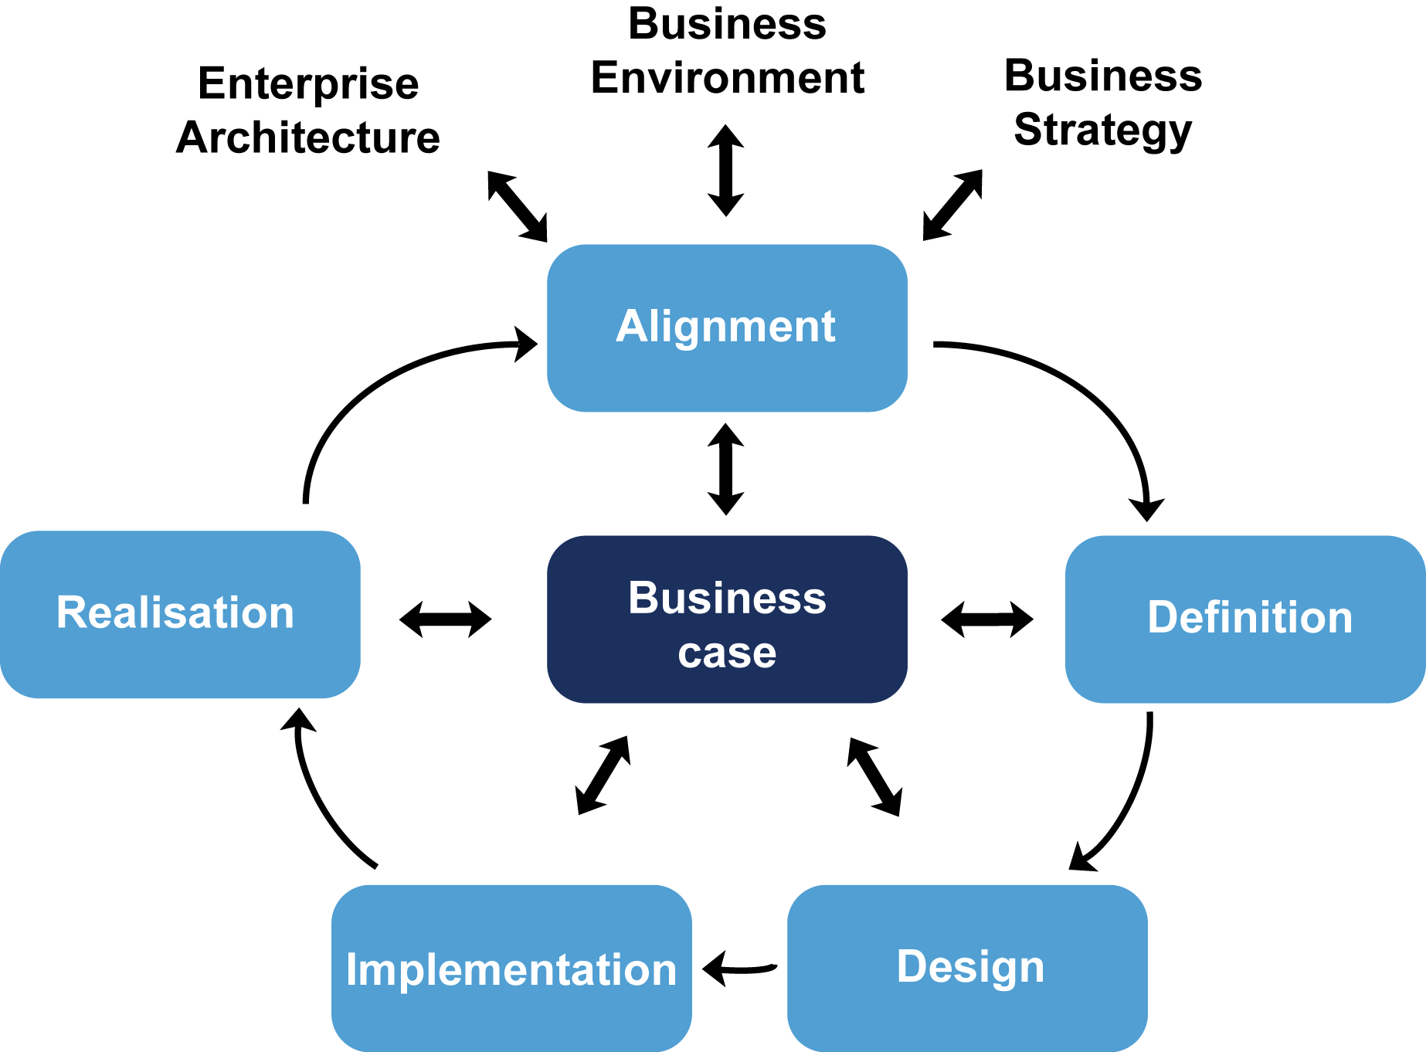
The Development of Business Analysis
BUSINESS NEEDS
The Business Analyst: Internal Consultant
Represents the needs of the business
OUTSOURCE TO REDUCE COST
ID Business needs and support implementation
USE I.T. FOR COMPETITIVE ADVANTAGE
SUCCESSFUL BUSINESS CHANGE
ID and manage requirements through to benefits realisation
Notes:
Pg 3
Over the last few years, many organisations have recognised that IT projects are not the answer to their changing business needs; what they need are business change programmes, which may incorporate IT projects.
With these programmes, there is the need for skills and roles to enable the successful delivery of business change.
The BA can represent the needs of the business, help identify and manage these needs through to implementation and ID and manage requirements from elicitation to benefits realisation (where applicable).

Slide 14
Successful Business Change
Notes:
Pg 4 & 5
The early part of the lifecycle shown above is concerned with the analysis of the organisation and its business needs, in order to determine more effective and efficient ways of working.
Focus on business problems and opportunities
Later activities are about change design and development, business acceptance testing and, following implementation, benefits review and realisation. Extensive analysis is required throughout the lifecycle and the nature of this work is clearly within the role of the business analyst.

Slide 15

Exercise 1 – Workshop / Brainstorm
What are the roles and responsibilities of a Business Analyst?
Notes:
Teams brainstorm and record on flipchart, then feedback to the group

Slide 16
The Role and Responsibilities of a Business Analyst
Core responsibilities:
Investigate business situation
Evaluate actions required to improve operation of business systems
Document and elaborate business requirements
Additionally:
Strategy implementation
Business case production
Benefits realisation
IT requirement specification
Notes:
Pg 12 - 13
Although different organisations define the role differently, there does seem to be common ground where most business analysts work:
Investigation of business systems, taking an holistic view of the situation. This may include examining elements of the organisation structures and staff development issues as well as current processes and IT systems.
Identifying actions required to improve the operation of a business system. Again, this may require examining the organisational structure and staff development needs to ensure that they are in line with any proposed process redesign and IT system development.
Documenting the business requirements for IT system support using appropriate standards.
Beyond these core responsibilities, there are others that may apply where the business analyst is in a more senior role or has chosen to specialise, as follows:
Strategy implementation, where the business analysts work closely with senior management to help define the most effective business systems to implement elements of the business strategy.
More senior business analysts may produce business cases, typically with assistance from finance specialists.
Involvement in post-implementation reviews to evaluate whether the benefits claimed in the business case have been achieved.
Specifying IT requirements using standard modelling techniques.

Slide 17
The Agile Approach
How does this work for a BA?
Support business users
Define, elaborate and prioritise business requirements
Collaborative, iterative approach to solution requirements
Impact analysis of functionality against the business needs and strategic direction
Notes:
Pg 10
Emerged in late 1990s
From Rapid Application Development (RAD) and the Dynamic System Development Method (DSDM)
Reaction to Waterfall’s linear approach
Agile Manifesto

Slide 18
The Scope of Business Analysis Work
Strategic Analysis and definition
Business Analysis
IT Systems Analysis
Localised business issue?
Analysis of a broad business area?
Specification of business requirements for a new IT system?
Analysis of a cross-functional business area?
Notes:
Pg 6 - 8
Business analysis has many guises and the actual work carried out will often depend on what the business needs from the analysis role.
Although strategic analysis is outside the remit of most BA jobs, it may be undertaken by some senior BAs in conjunction with senior management and strategy consultants.
Most BAs will have a role to play in supporting this activity, and will need to have access to and understand their organisation's business strategy, as their work will need to support the achievement of this.
Systems analysis is about analysing and specifying requirements for IT systems so that the organisations can evaluate software packages or develop bespoke IT systems to support their business processes. It will involve the use of techniques such as data modelling and process or function modelling.
Some organisations may consider that this work is technical in nature and therefore outside the scope of the BA role, but many organisations do not have a clear distinction; which has led to many and varied job titles with "analyst" in them.
Whether the BA gets involved with the systems analysis or not, they need to have an awareness of the IT systems as they exist to meet business requirements.
Beyond the core responsibilities, there are others that may apply where the business analyst is in a more senior role or has chosen to specialise, as follows:
Strategy implementation, where the business analysts work closely with senior management to help define the most effective business systems to implement elements of the business strategy
More senior business analysts may produce business cases, typically with assistance from finance specialists
Involvement in post-implementation reviews to evaluate whether the benefits claimed in the business case have been achieved
Specifying IT requirements using standard modelling techniques

Slide 19
Taking a Holistic Approach
Organisation
People
Information and Technology
Processes
POPIT™
Notes:
Pg 9 - 10
Mnemonic POPT/POPIT
Four views to consider when identifying areas for improving a business system.
BA needs to consider all four aspects
The processes are they well defined and communicated
The people do they have the required skills for the job
The organizational context is there a supportive management approach?
Information technology is helpful in supporting business change

Slide 20
The Business Analyst Role Definition
"An advisory role which has the responsibility for investigating and analysing business situations, identifying and evaluating options for improving business systems, elaborating and defining requirements, and ensuring the effective implementation and use of information systems in line with the needs of the business"
Business Analysis (BCS 2014 p.12)
Notes:
Bp12

Slide 21
Role and Responsibilities
Guiding principles (the rationale) for business analysis:
Root causes, not symptoms
Business improvement, not IT change
Options, not solutions
Feasible, contributing requirements
Entire business change lifecycle
Negotiation, not avoidance
Notes:
Bp13
Note that the guiding principles have been renamed as the ‘rationale for business analysis’ and the final one has been removed.

Slide 22
The Capability Maturity Model Integration (CMMI)
CMMI
Developed by Software Engineering Institute (SEI)
Approach to process improvement
Assesses the level of maturity of an organisation at 5 levels:
Optimising
Continuous improvement practised
Qualitatively managed
BA work measured and controlled
Defined
BA approach is tailored
Managed
BA techniques and processes reused
BAMM
Developed by Assist KD
Represents the development and maturity of business analysis
Initial
Business analysis used in the organisation
Notes:
BAMM Pg 13
CMMI Pg 15
Slide builds to show the CMMI applied to Business Analysis (based on the BAMM approach)

Slide 23
2. The Competencies of a Business Analyst
Personal qualities
Business knowledge
Professional techniques
Developing competencies
Notes:
Chapter 2, pg 19

Slide 24
Competencies of a Business Analyst
Competencies of a business analyst
Personal qualities
Business knowledge
Professional techniques
Notes:
Bp19
Mnemonic – PBP

Slide 25

Competencies – Personal Qualities
Communication
Relationship building
Influencing
Team-working and political awareness
Analytical skills and critical thinking
Attention to detail
Problem-solving
Leadership
Self-belief
Professional development
Notes:
Pp 20 – 24
New one added

Slide 26

Competencies – Business Knowledge
Business finance and the economy
Business case development
Domain knowledge/subject matter expertise
IT principles
Organisation structures
Supplier management
Business Architecture
Notes:
Pp 24 – 27
New one added

Slide 27

Competencies – Professional Techniques
Project management
Strategic analysis
Stakeholder analysis and management
Investigation techniques
Requirements engineering
Business and data modelling
Gap analysis
Facilitation skills
Portfolio management
Benefits management
Agile thinking
Notes:
Pp 27 – 29
Note this has been amended to include the last 3 points. Modelling now combines systems and processes.

Slide 28
How Can I Develop My Skills?
Training
BCS Professional Certifications
Self-study
Reference books
Business publications
Internet
Workplace experience
Industry engagement
BCS
IIBA
Business Analysis Diploma?
Notes:
Pp 31 - 32

Slide 29
Skills Framework for the Information Age (SFIA)
SFIA and SFIAplus – frameworks for the definition of skills and competencies in the information systems industry
SFIAplus provides more detail than SFIA and should be treated as a standard
SFIA may be tailored to an organisation’s needs
Notes:
Pp 32 - 33
SFIA is a not for profit organisation, representatives from BCS, eskills UK, IET, IMIS and ISMF

Slide 30
3. Strategy Analysis
The context for strategy
External environment analysis
Internal environment analysis
SWOT analysis
Executing strategy
Strategy development
The definition of strategy
Notes:
Chapter3, pg 38
Note that due to comments from delegates the BA PM has been moved to after this section to fit with the sequence of the book. If you wish to introduce the BA PM here then that’s an option.
Also note that Implementing Strategy has been renamed Executing Strategy

Slide 31
The Context – What is Strategy?
Military origins
Business must deal with:
The goal or mission of the business – where are we headed?
The time frame – business specific definition – long term
Organisation of resources – makes the business competitive
The environment in which the business operates
“Strategy is the direction and scope of an organisation over the long term, which achieves advantage in a changing environment through its configuration of resources and competencies with the aim of fulfilling stakeholder expectations”
Johnson, Scholes and Whittington (2008)
Notes:
Pp 39 - 40

Slide 32
Strategy Development
Where to start?
Where does strategic development originate?
What kind of strategy do we develop?
Rational, logical approach
Strategy formed through political ‘power’
Notes:
Bp41
Note that the lenses have been removed from edition 3 and the focus has changed a bit to use the entre/intra/formal methods as starting points

Slide 33
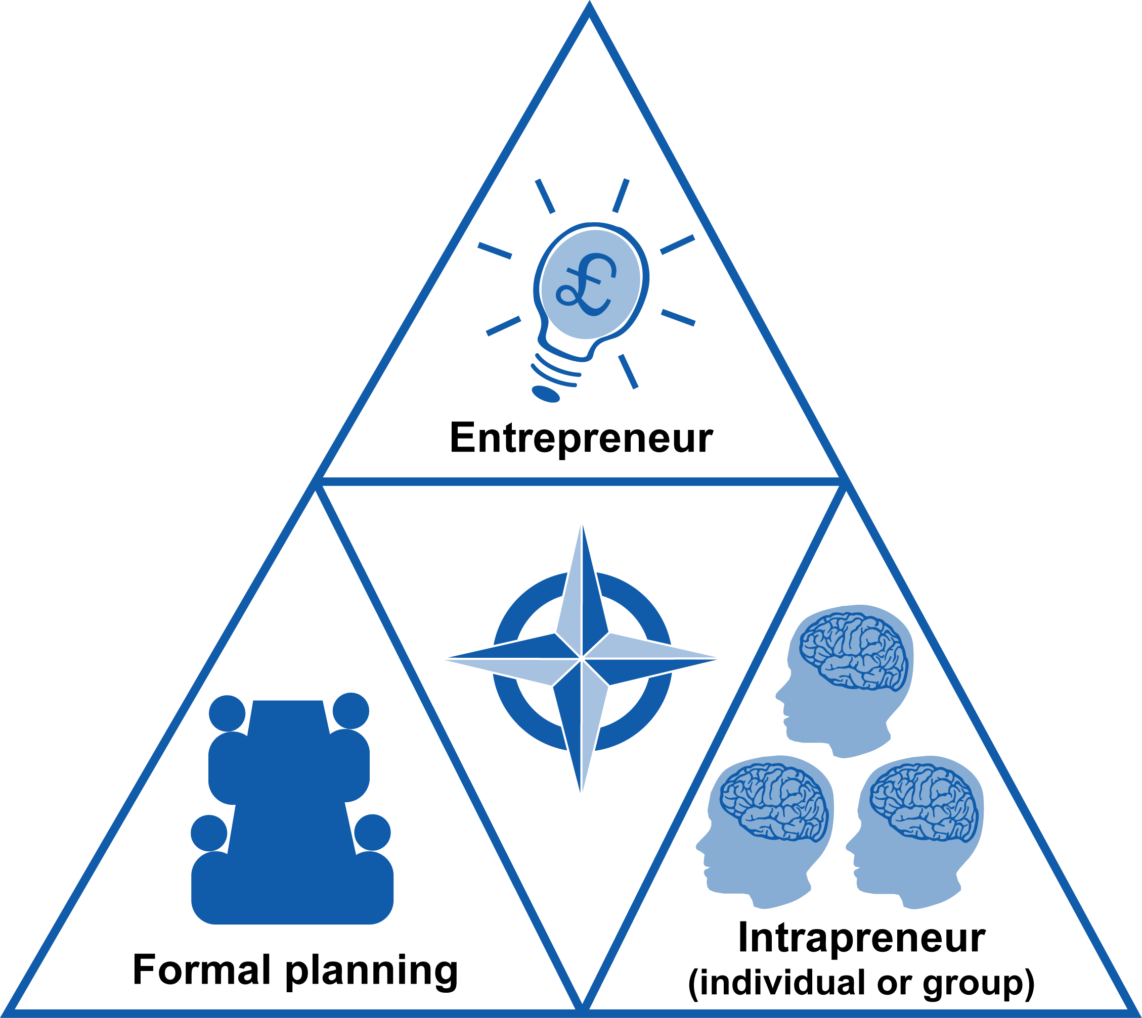
Rational, Logical Approach to Strategy
Notes:
bp41

Slide 34
Strategy Formed Through Internal Political Power
Strategy formed through the exercise of political ‘power’:
Dependency
Financial Resources
Position
Uniqueness
Uncertainty
Notes:
Pp 41 – 42
Strategy is derived through a prominence of a politically powerful source within the company.
Dependency – control of resources, for example HR
Financial resources – who controls the budgets?
Position – is there a hierarchical organisation structure?
Uniqueness – the group with the power is unique
Uncertainty - the ability to best cope with the challenges

Slide 35

A Written Statement of Strategy
If only this page wasn’t blank…
Provides:
Focus
Framework
Guide to innovation
Performance measures
Guidance for the outside world
Notes:
Pg 42
Why do we need one? Why is this important?

Slide 36
Strategic Analysis Techniques
External Tools
PESTLE
Scenarios
Porter’s 5 Forces
SWOT: Opportunities and threats
Internal
MOST analysis
Resource audit
Boston box
SWOT: Strengths and weaknesses
Strategy Execution Tools
McKinsey 7-S model
Balanced business scorecard
CSFs and KPIs

Slide 37
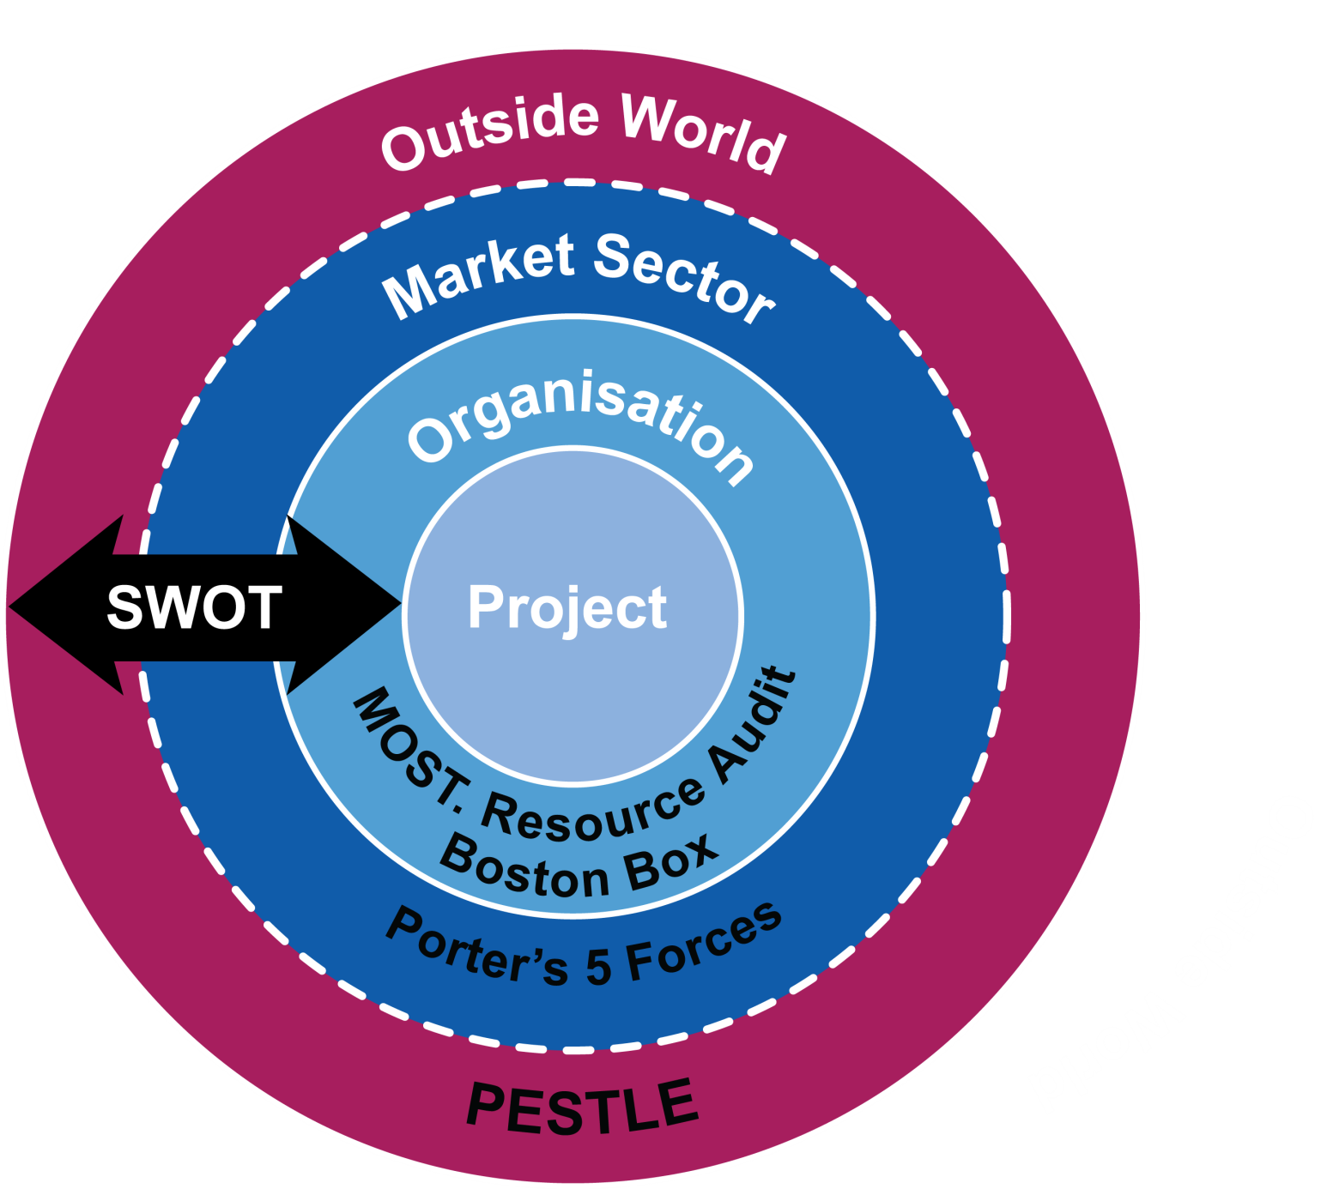
The Business Domain
Notes:
Any organisation can be affected by various external factors, we use a number of industry standard approaches to try to understand the external world.

Slide 38
External Analysis – PESTLE
Factors that affect the organisation but are outside its control
Political
Economic
Socio-cultural
Technological
Legal
Environmental
Government stability and policies, trade etc.
how easy or not it is for a business to be profitable
population, social mobility and lifestyle wants and needs
innovation, spend on research, technology-enabled businesses
legislation and laws at an international, national and local level
ecological issues and laws, i.e. climate change
Notes:
P 43 - 44
External factors are factors beyond the direct control of the business, but which affect the business conduct in some way.
An example of an ‘Economic ‘factor might be Central Bank Interest Rates, if the business has loans or is seeking to obtain loans in the long term.
These factors may represent Threats and/or Opportunities, when we consider them within SWOT.
Can extend to create SCENARIOS

Slide 39
External Analysis – PESTLE Example
Vehicle Rental Company
P
Different country policies on tax, insurance and driver age limits
E
Spending power of customers affecting frequency of rentals
S
Alternative transport options
T
Ability to use GPS, hands-free phone and so on.
L
Vehicle maintenance, tax and insurance
E
Fuel consumption, pollution and carbon footprint

Slide 40
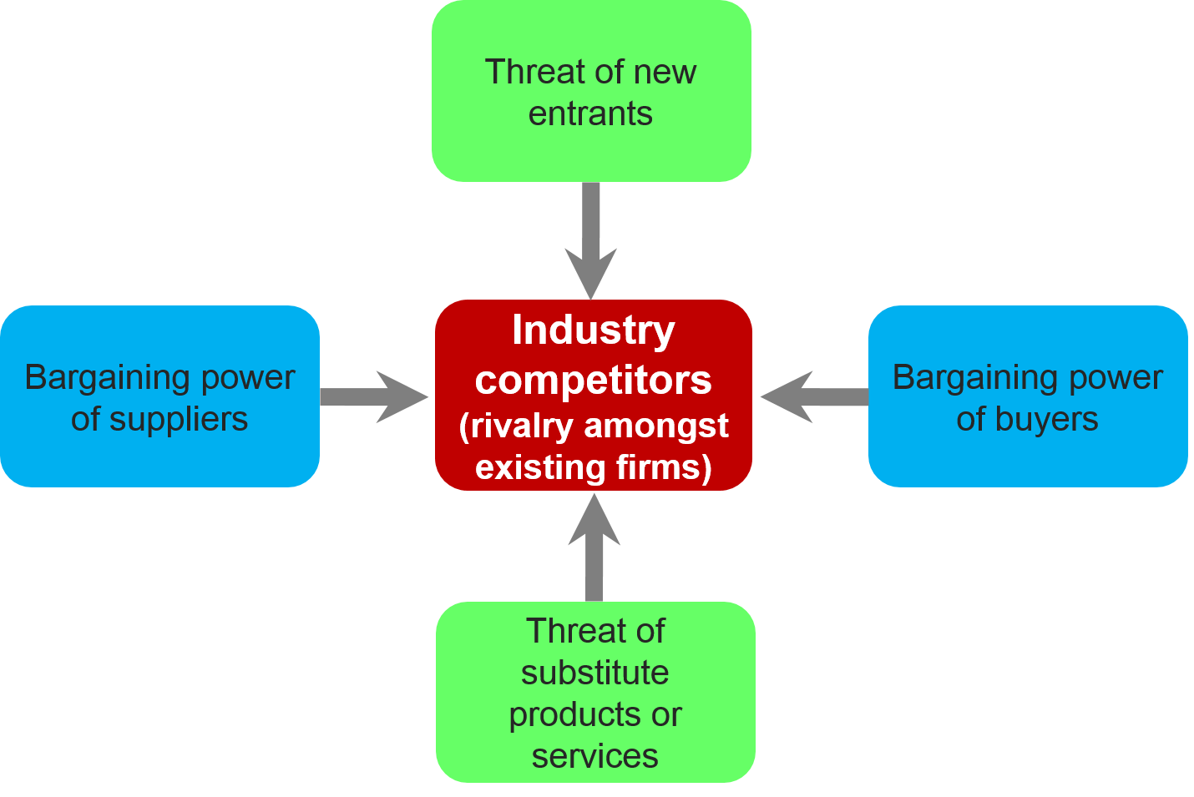
External Analysis – Porter’s 5 Forces
A framework for business management to determine the attractiveness of a marketplace
Notes:
Bp45
The Porter 5 forces analysis is a framework for business management developed by Michael Porter in 1979, to determine the attractiveness of a marketplace. Four forces – the bargaining power of customers, the bargaining power of suppliers, the threat of new entrants, and the threat of substitute products - combined with other variables to influence a fifth force, the level of competition in an industry.
This framework can help to identify strategic targets; for example if Suppliers are powerful, then our strategy should be to reduce this power, for example by acquiring the Suppliers involved (Vertical Integration).
What could be done about strategic threats from the other forces?

Slide 41
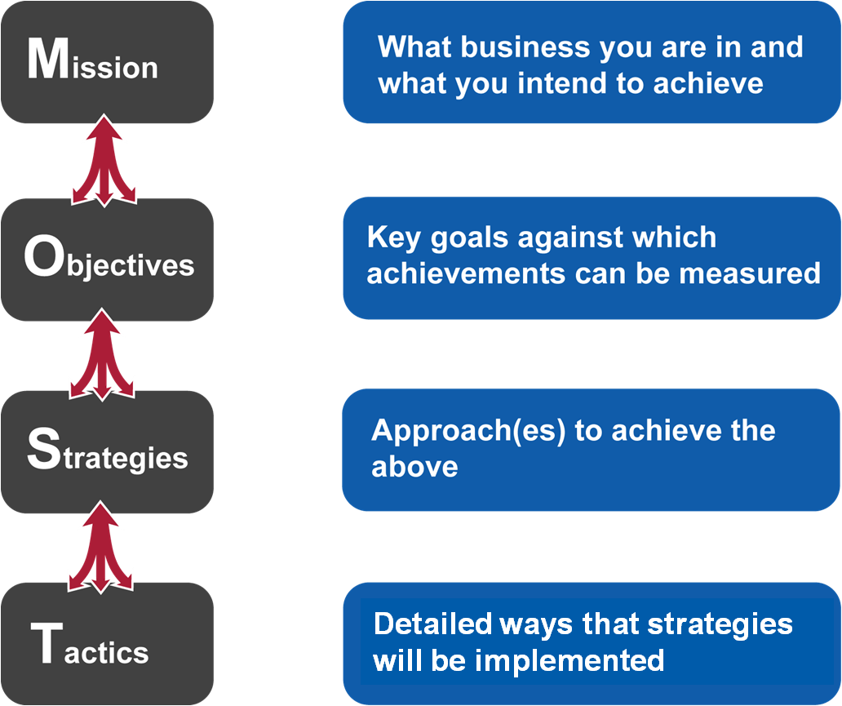
Internal Analysis – MOST
Notes:
Bp47 - 48
One of the key tools used in exploring corporate strategy and Strategic Planning is the M.O.S.T. Analysis. This helps to clarify what business the organisation is in and what it intends to achieve (Mission), they key goals which will help to achieve this (Objectives), the approach that is going to be taken to achieve these (Strategies) and how these strategies are going to be put into action (Tactics).
This process should work from top to bottom and also in reverse. From the top, clarifying the mission drives the objectives which creates strategic options which forces tactical actions to be taken. From the bottom, every action at tactical level should help to make the strategies work, all strategies should help to achieve the objectives, and all the objectives should take the business towards the mission.
Businesses fall into many traps by attempting to tackle strategy only internally -
Getting distracted from moving the business forward by day-to-day actions or demands from customers, suppliers and competitors
Failing to clarify where it wants to get to and in what timescale
Omitting to get Board and management agreement to this mission
Not clarifying the key objectives that need to be reached (and in what timescale) for the mission to be successful
Not getting external and objective assistance in analysing the strategic options available to satisfy the key objectives
Missing out the strategy stage altogether by going straight from objectives to tactics which leads to a lot of "dead ends"
Not ensuring that everything done at tactical level helps to ensure success of the strategies
Failing to properly define timescales, responsibilities, monitoring and control procedures to ensure that implementation moves forward at the necessary speed

Slide 42
MOST Example
MISSION
OBJECTIVE
STRATEGY
TACTIC
To be the number one vehicle rental company in the UK
Target loyal consumers
Contact all customers who have rented vehicles at least once per month over a 6 month period and provide 25% discount offer on next rental on sign up to loyalty scheme
To increase volume of standard rentals by 25% over 2 years
Notes:
Some completely made up examples for a vehicle dealership.
Note that there will only be one Mission, but this may lead to several Objectives, each of which may lead to several Strategies, each of which may lead to several Tactics.

Slide 43
Internal Analysis – Resource Audit
‘Inside-out’ approach
Competitiveness – the ability to create new products and services from core competences
Competency resource audit
Tangible resources
Physical, Financial, Human
Intangible resources
Know-how, Reputation
Notes:
Bp48
Tangible resources
Physical (buildings, plant, equipment, land)
Financial (cash-flow, investment, market fluctuations)
Human (people, expertise, adaptability, motivation)
Intangible resources
Know-how (use of technology or resources specific to business)
Reputation (brand image)

Slide 44
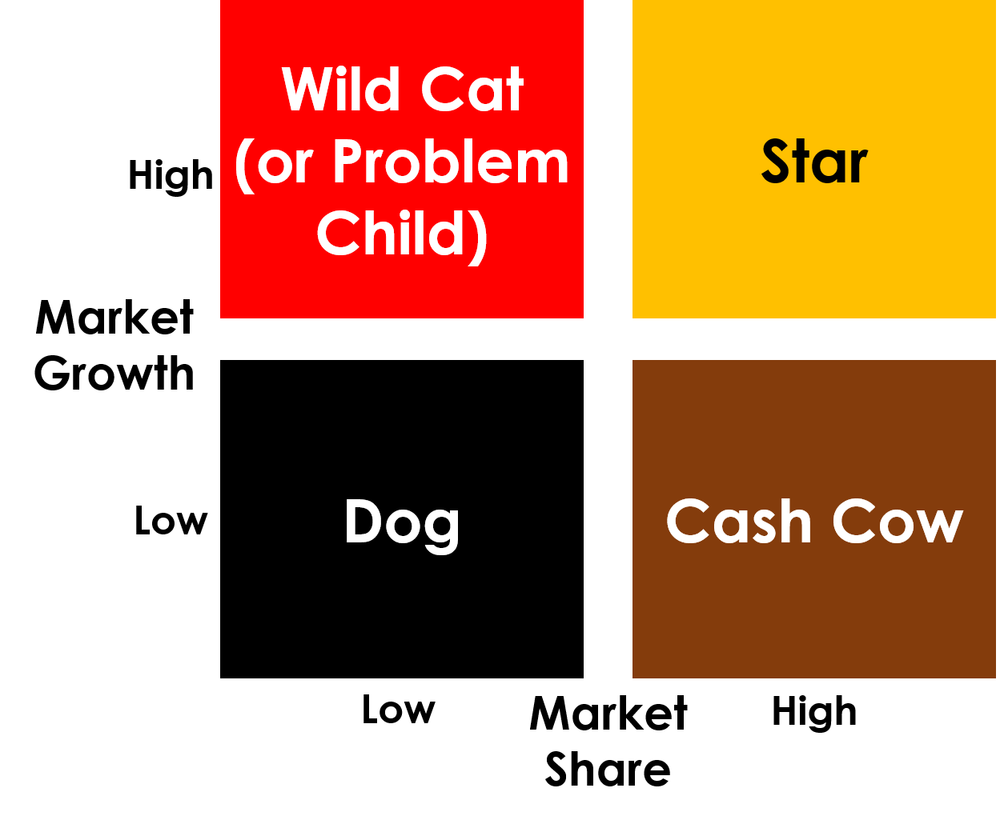
Internal Analysis – Boston Box
Boston Box
Wild cat (new entrant)
Star (growth)
Cash cow (mature)
Dog (decline)
Notes:
Bp 49
Also known as portfolio analysis or a portfolio matrix
Wild cat (red cat) = new entrant
Star (Gold star) = growth
Cash cow (Brown cow)= mature
Dog (Black Dog) = decline
Also has a lifecycle starting with Wild Cat

Slide 45
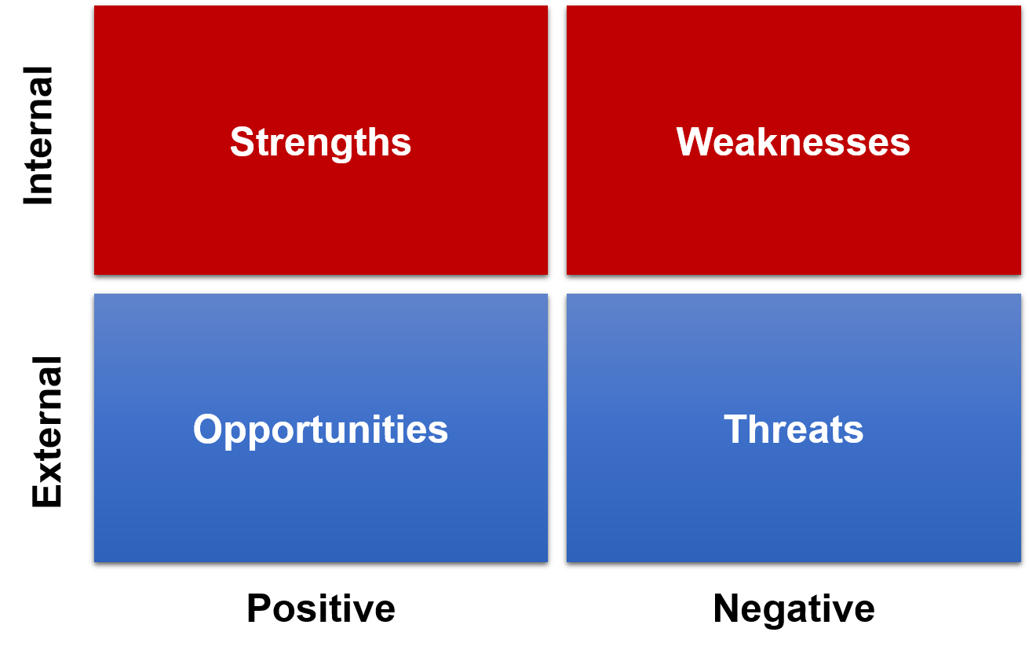
SWOT Analysis
Notes:
bp49
SWOT is a technique for bringing together the results of investigating both the internal and external environments.
There are 4 lists initially – Strengths, Weaknesses, Opportunities and Threats.
Internal:
Strengths: what we already do well
Weaknesses: what we need to improve
External:
Opportunities: external things we can exploit
Threats: external things we need to be aware of
The trick then is to look for useful combinations of these factors, which may lead to suggestions for suitable business strategies.

Slide 46
Exercise 2
Carry out a PESTLE analysis on the case study.
Where are the opportunities and threats?
Notes:
Teams brainstorm and record on flipchart, then feedback to the group

Slide 47
Executing Strategy
The context for strategy execution: five key issues
Time: how quick?
Scope: how big is the change?
Capability: change process in place?
Readiness: responsiveness?
Strategic leadership
Tools
McKinsey 7-S model
Balanced Business Scorecard
Critical Success Factors and Key Performance Indicators
Notes:
Bp51 – 54
A note on strategic leadership
When we talk about a strategic leader in this context we are talking about someone who has a key role in the change. Someone who:
Challenges the status quo
Established and communicates a clear vision
Models the way – gets stuck in and shows everyone how it’s done
Empowers people
Celebrates success

Slide 48
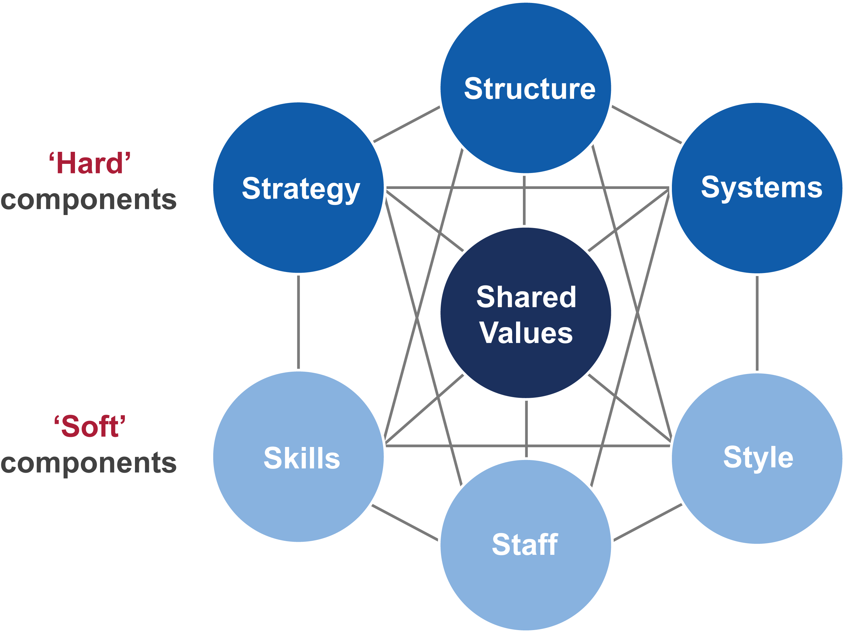
McKinsey 7-S
Notes:
Bp52
This tool helps to understand the impact of changes by viewing the organisation as seven components all connected to each other. They can be seen as levers.

Slide 49
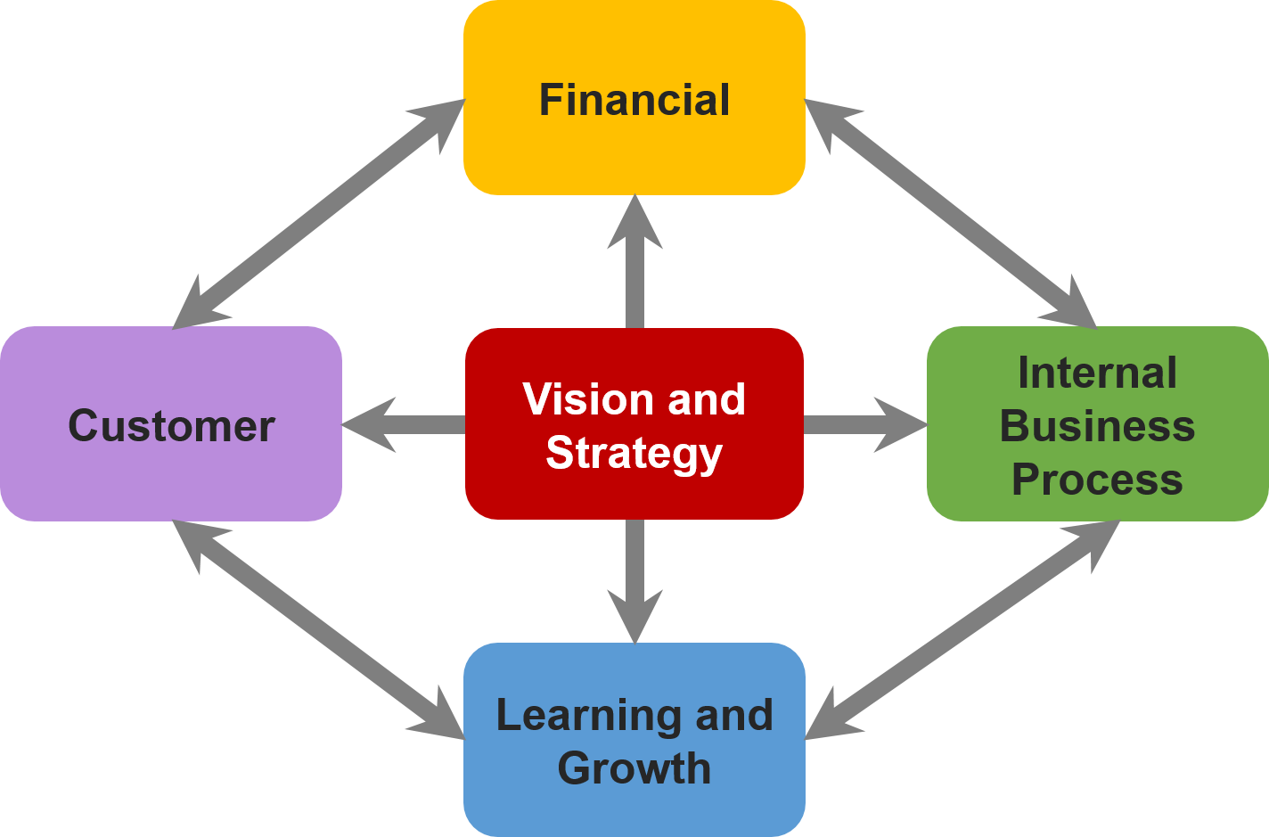
The Balanced Business Scorecard
F
C
I
L
Ensures we consider more than just financial components of a strategy – components are interlinked
A framework for identifying CSFs and KPIs
Notes:
bp53
Balanced Business Scorecard is a method and a tool which includes:
a strategy map where strategic objectives are placed over four perspectives in order to clarify the strategy and the cause and effect relationships that exists among them.
strategic objectives which are smaller parts of the strategy interlinked by cause and effect relationships in the strategy map.
measures directly reflecting strategy. Their prime purpose is to measure that the desired change or development defined by strategic objectives actually takes place.
strategic initiatives that constitute the actual change as described by strategic objectives.
The scorecard drives implementation of strategy using the four perspectives shown above.
Specific measures are chosen based upon the organisation's goals. Typically organisations "get what they measure" so care in creating measures and revisiting the measures regularly is recommended by most practitioners.
The method helps separate creation of strategy from strategy implementation, which can push power downwards while making the leaders' jobs easier. It can also help detect correlation between activities. For example, the process objective of implementing a new telephone system can help the customer objective of reducing response time to telephone calls, leading to increased sales from repeat business.
Companies are using the scorecard to:
Clarify and update budgets
Identify and align strategic initiatives
Conduct periodic performance reviews to learn about and improve strategy

Slide 50


Critical Success Factors and Key Performance Indicators
CSF – the things an organisation must be good at in order to succeed
e.g. ‘excellent customer service’
KPI – the things an organisation measures to find out how well it is doing
e.g. Customer Satisfaction rating of 85% or higher each month
Notes:
bpg54

Slide 51

4. Business Analysis Process Model
An approach to creative problem solving
The Process Model stages
Objectives of the Process Model
Procedure and Techniques used
Notes:
Chapter 4, bp56

Slide 52
Exercise 3
Consider the problems with business change projects.
Why do they fail?
Notes:
Teams brainstorm and record on flipchart, then feedback to the group

Slide 53
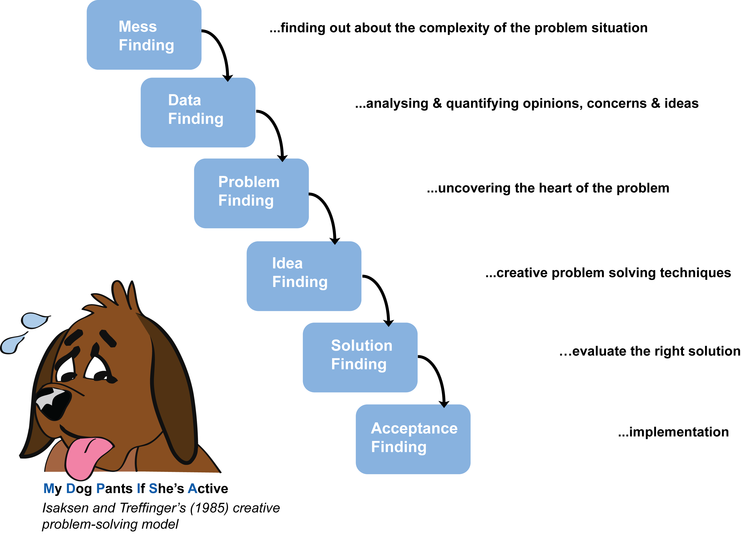
An Approach to Creative Problem-solving
Notes:
Bp56 – 58
One of the issues faced by BAs is that we examine the entire problem area to provide a thoughtful, and often, creative approach to problem solving.
Isaksen and Treffinger’s problem solving model allows us to frame the approach to problems by first understanding the issues and related complexities, rather than jumping to conclusions which may not be correct (goes back to rationale criteria ‘options not solutions’ and ‘root causes, not symptoms’)
First three stages are about finding out. Then developing solutions in the next two.

Slide 54
Contextualising the Business Analyst Work
Terms of Reference / Project Initiation Document
Objectives
Scope
Constraints
Authority
Resources
Notes:
Pg 59
The Terms of Reference (TOR) helps to provide a framework for the project. It is useful to the Business Analyst as it helps to define what needs to be done.
A useful structure for the TOR, which helps to clarify the context, is OSCAR:
Objectives
The Business Objectives and the Project Objectives
Must be SMART
Scope
What is IN SCOPE for the project (i.e. within the project boundary)
What is OUT OF SCOPE for the project (i.e. outside the project boundaries)
Constraints
Any constraints that will impact the project, timescales, geographical needs etc.
Authority
Who is responsible for signing off and making decisions with regards to the project?
Resources
Who will carry out the project?
Sometimes you will see BOSCARD used to describe the TOR instead of OSCAR (B=Background, D=Deliverables).
The Project Initiation Document (PID) or similar, is usually seen as the document which forms the contract for the project and is a project management artefact.

Slide 55
Business Analysis Approach
Business Context
Investigate Situation
Consider Perspectives
Analyse Needs
Evaluate Options
Define Requirements
Chapter 5
Chapter 6
Chapter 7, 8
Chapter 9
Chapter 10, 11, 12
Notes:
bp58
The model shown above sets out key stages for a business analysis project with each stage representing areas that may need to be considered. Note that not all projects will require all stages. One of the most important aspects of a business analysis project is to decide what the focus is and what areas need investigation.
Pg 58 - 69
Each stage of the Business Analysis Process Model has an objective, some form of procedure and techniques that can be applied to meet the objectives.
At each stage we need to factor in consideration of the Business Strategy and Objectives.
Each stage has an objective and these are covered in the chapters we will follow for the remainder of the course:
Investigate Situation – uncover issues and problems, define scope for the investigation via a ToR (OSCAR) – see chapter 5
Consider Perspectives – analysing stakeholders and understanding their perspectives – see chapter 6
Analyse Needs – In this stage we need to undertake a gap analysis. We analyse where the improvements are required and look at activities and business processes – see chapters 7 (and for further information chapter 8)
Evaluate Options – With the information gathered so far we must consider what is possible, that is assess the feasibility and create a business case to document the options and gain agreement – see chapter 9
Define Requirements – this stage considers the areas of the business relevant to the POPIT model – see chapters 7, 10, 11 and 12

Slide 56
Extended BA Process Model
Business Context
Investigate Situation
Consider Perspectives
Analyse Needs
Evaluate Options
Define Requirements
Deliver Changes
Chapters 13 & 14
Notes:
Bp69
Deliver Changes – this stage is about implementation of the changes and as it is often not solely the responsibility of the Business Analyst is covered as an extension of the Business Analysis Process Model – see chapters 13 and 14

Slide 57
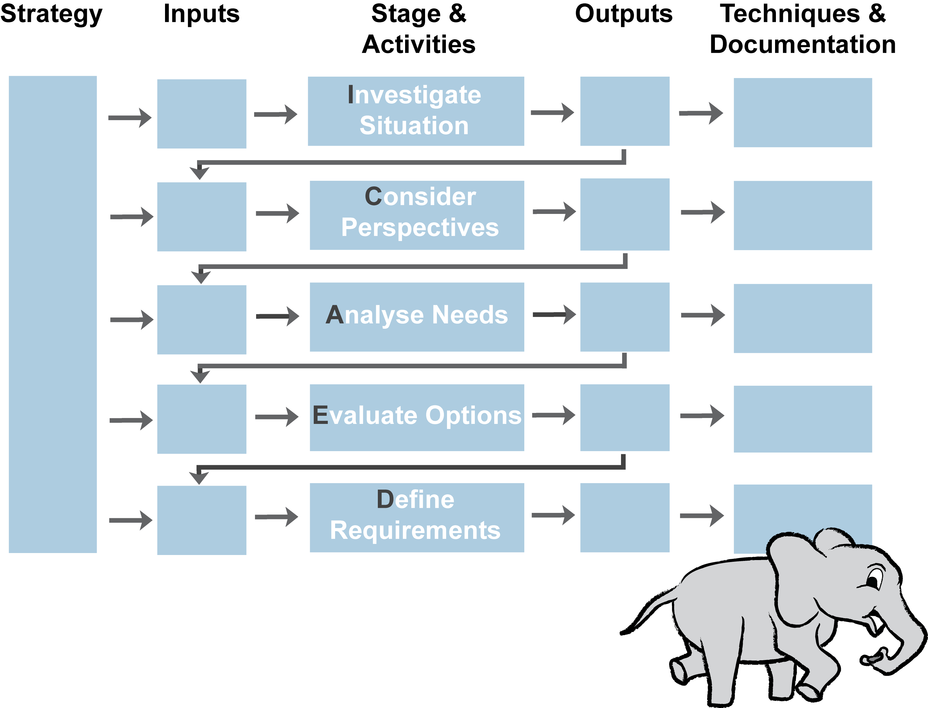
BA Process Model – Revision Aid
Notes:
I Call All Elephants Dumbo

Slide 58
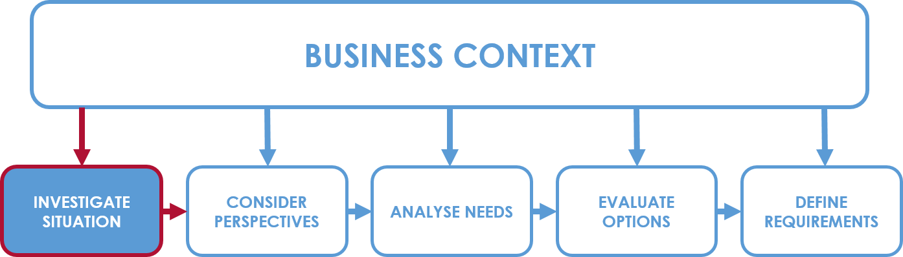
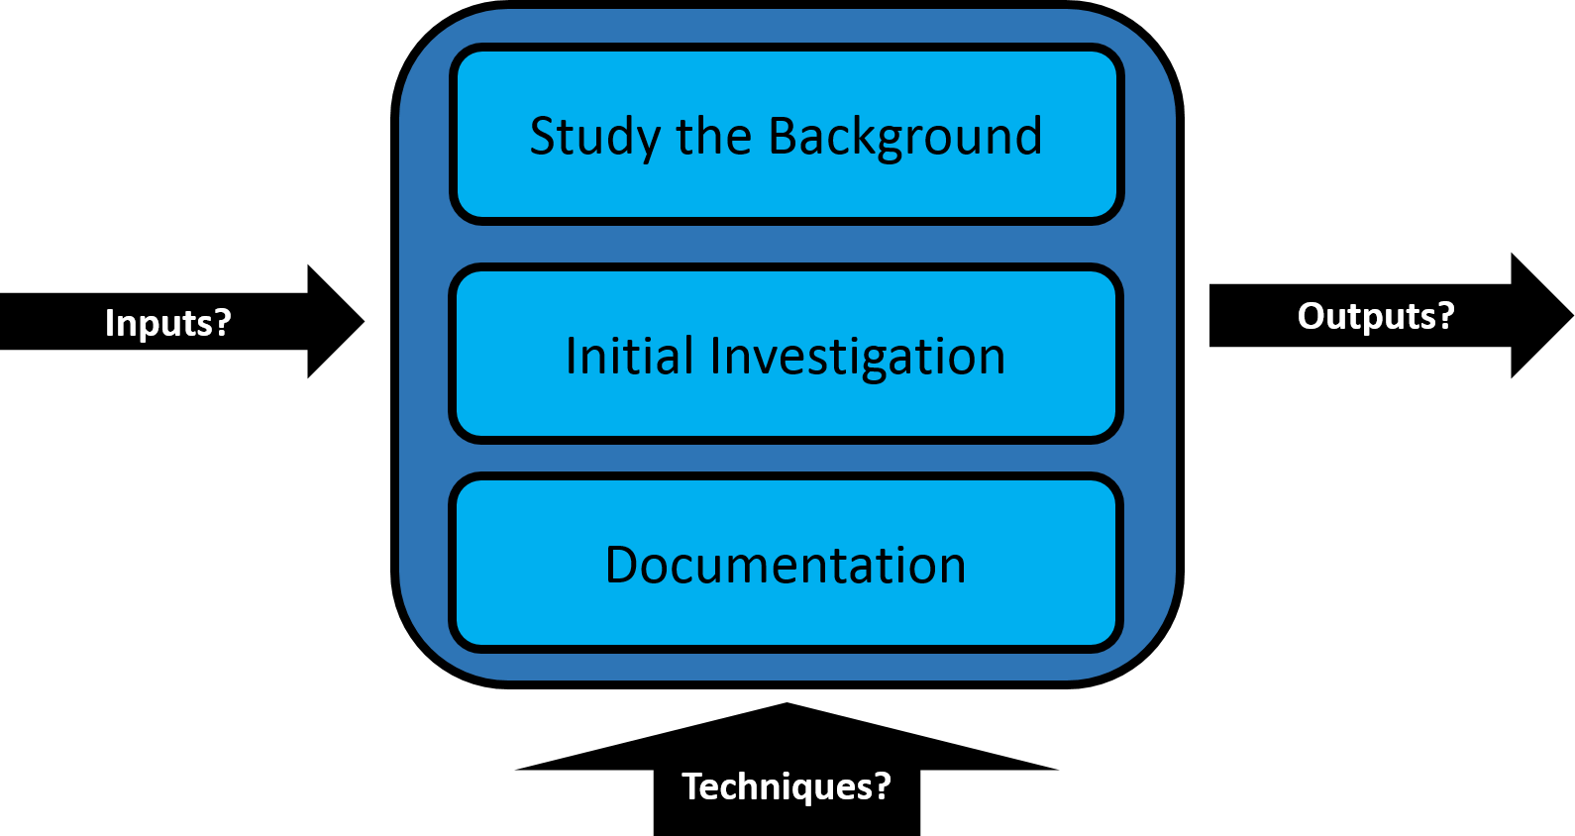
5. Investigation Techniques
Investigate Situation
Business Analysis Process Model: Investigate Situation
Notes:
Chapter 5, bp72

Slide 59
Study the Background
Investigate Situation
Research the business area!
Lots of areas available to us:
The Company website/competitor/supplier websites
Company reports
Procedure manuals and documentation
The Organisation Chart
Even social media nowadays
Different investigation techniques available:
Qualitative
Quantitative
Notes:
Pg 72
Qual – understanding what is needed
Quant – volumes and frequencies

Slide 60
Investigation Techniques - Interviews
Investigate Situation
A structured discussion between an Analyst and a Stakeholder
Usually a one-to-one meeting
Building rapport
Yielding important information
Confidentiality
Time consuming
Information must be verified
Right people interviewed
Asking the right questions
P
O
Preparation
Conduct
Follow up
Who? (STOP)
Open
Write up notes
Why?
What?
When? And where?
Body of the interview
Close
Distribute and check
Notes:
Note that the STOP model is in the delegate guide under this slide. In case anyone

Slide 61
Investigation Techniques - Observation
Investigate Situation
Watch what people do either by formal agreement or informally by just ‘wandering about’
Better understanding of problems
Seeing the task in the user’s environment
Uncovering tacit knowledge
Users may feel self-conscious
You may not see everything you need to see…
P
O
Formal Observation
Protocol Analysis
Shadowing
Watch a task
Describing each step for a task
Following a user
Needs prep
Can uncover tacit information
Suited to manual tasks
E.g. Learning to drive
Uncovers tacit knowledge
Ethnographic Studies
Extended period of time
Can unravel complexity

Slide 62
Investigation Techniques - Workshops
Investigate Situation
A structured meeting moderated by an impartial facilitator to achieve an agreed objective
Gain a broad view of area
Increase speed
Obtain buy-in and acceptance
Gain consensus
Time-consuming
Needs careful facilitation
Participants need required level of authority
P
O
Preparation
Facilitation
Techniques
Objective
Discovery:
Write up key points
Participants
Structure
Venue
Empower the participants
Record key points
Summarise at the end
Round robin
Following the workshop
Brainstorming
Post-its (for ideas)
Distribute
Visualisation:
Process models
Rich pictures
Notes:
Pg 82 – 86
Also now mentions Hothouse workshops and Focus Groups as part of the same subject

Slide 63
Investigation Techniques - Workshops
Investigate Situation
Hothouse workshops
Focus on a specific business problem
Lean and Agile principles used
Intense, iterative approach
Prototype-driven
Typically geared towards innovation
Often at executive level
Focus Groups
Business and market research
Common interest, sample group
Attitudes and opinions on a specific topic
Findings need to be assessed after the focus group
Not aiming for consensus
Notes:
Pg 82 – 86
Also now mentions Hothouse workshops and Focus Groups as part of the same subject

Slide 64
Investigation Techniques - Scenarios
Investigate Situation
Tell a ‘visual’ story of a task or transaction
All steps included
Tacit knowledge is uncovered
Top down approach
Can be used for developing prototypes and test scripts
Time-consuming
Can become overly complex
P
O
Process
Documenting
ID task
ID steps and sequence
Define control conditions
ID exceptions
Use Case Descriptions (from UML) are popular
Storyboards
Activity diagrams
Task modelling/decision trees
Notes:
Pg 87 - 90

Slide 65
Investigation Techniques - Prototyping
Investigate Situation
Creating a ‘demonstration system’ to help clarify vague requirements
Closely linked to scenarios
O
P
Clarifies uncertainty and confirms understanding
Helps ID requirements
Demonstrate the look and feel of the system
Validate system requirements
Usability and user journey paths
Endless iterations
The users can expect that the system has been finished
The final appearance of the system needs to be realistic to manage user expectations
Approaches
Using organisation’s software/systems
Screen mockups (wireframes using software, paper etc.)
Flipchart, pens and post-its
Notes:
Pg 82 – 86

Slide 66
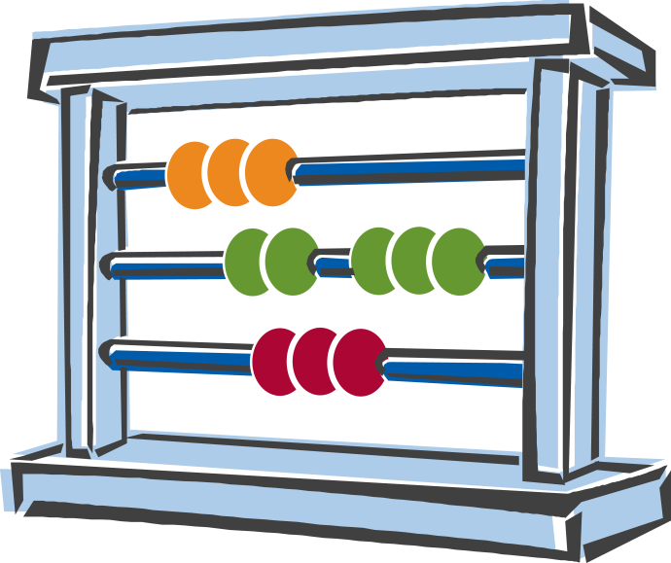
Quantitative Approaches
Investigate Situation
Questionnaires or Surveys
Special-purpose records
Activity sampling
Document Analysis
Notes:
Bp93. 94
Questionnaires or Surveys
More effective than interviews if there are many people
Care needed with the design
Heading (purpose)
Classification section (user category)
Data section
Response rate can be low
Special-purpose records
‘5-bar-gate’ tally chart etc.
Self-observation for users
Requires buy-in from the ones doing it
Must be realistic to do during the working day
Activity sampling
More quantitative form of observation
How are people spending time?
How they apportion time to different activities?
5 steps:
Identify what activities to record
Decide frequency and timings
Visit and record what happens
Record the results
Analyse the findings
Document analysis
Reviewing and analysing source documentation such as forms, screen layouts and reports
Helps to uncover information:
How it is completed
Who uses it
When it is used
How many are used/produced
Document retention
Details included

Slide 67
Suitability of Techniques
Investigate Situation
Investigation technique | Understanding the situation | Waterfall | Agile
Interview | PP | PP | PP
Observation | PP | PP | P
Shadowing | PP | PP | P
Workshop | PP | PP | PP
Hothousing | P | O | PP
Scenarios | P | PP | PP
Prototyping | P | PP | PP
Questionnaires | PP | PP | O
Special Purpose Records | PP | PP | O
Activity Sampling | PP | PP | O
Document Analysis | PP | PP | O
Notes:
Pg 97
Gaining an understanding of the situation
Waterfall requirements elicitation
Agile requirements elicitation
Two ticks is best for that approach
One tick is ok
A cross is not ok

Slide 68
Documenting the Current Situation
Investigate Situation
Once investigated, findings need to be recorded
Written reports for formal documentation
Graphical techniques are quicker to produce. Examples are:
Rich pictures
Mind maps
Also useful, but not in the syllabus:
Business process models
Spaghetti maps
Fishbone (Ishikawa) diagrams
Business needs log
Notes:
P 97
Rich picture on next slide
Mind map on one after

Slide 69
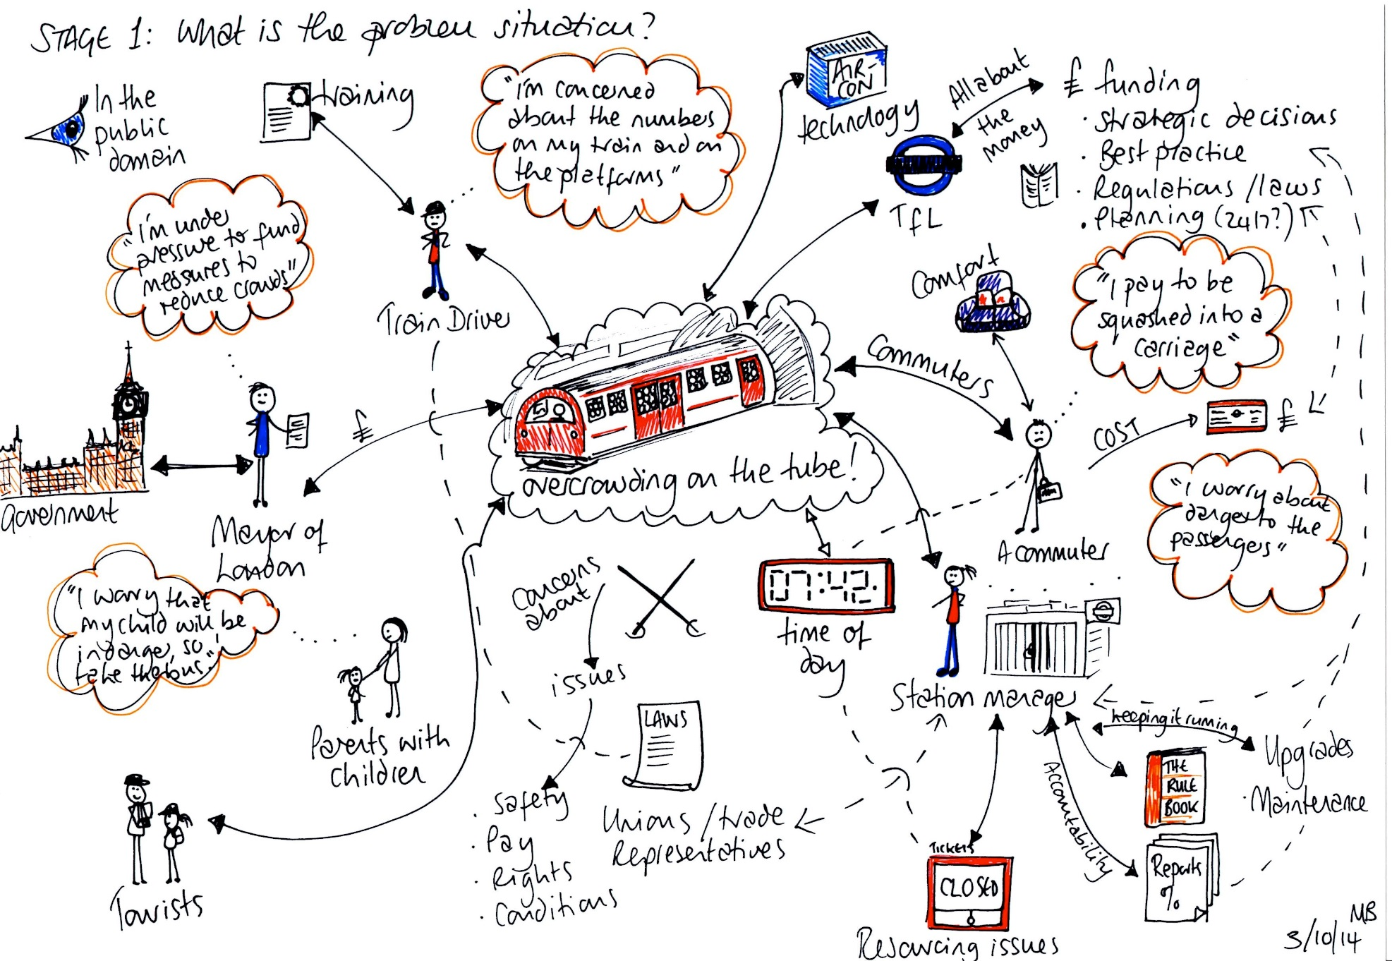
Documenting the Current Business Situation - Rich Pictures
Investigate Situation
Notes:
bp98
Checkland recommends a rich picture to represent the current business situation, but mind maps, fishbone diagrams and other tools can be used instead. However, techniques from hard systems such as data flow diagrams or object models are not sufficiently versatile or ‘rich’.
One of the problems with investigating business situations is that they are rarely clear cut. Although some of the structured modelling techniques provide a clear view of one perspective (e.g. data or process) they are not able to show the range and variety of issues that may be uncovered. Interpersonal, political and cultural issues are rarely documented , even if they are evident. If such issues are not taken into account then recommendations may be rejected and the implementation of solutions may be deeply problematic. Rich pictures provide a free-format approach to allow analysts to document whatever is of interest or significance. This often includes details of processes, stakeholders, issues raised and the culture inherent in the situation.
There is no single way of drawing a rich picture. An analyst may find different styles useful in different situations. Ideally the rich picture is captured on one page and hence provides a distilled view of all aspects to be considered. This helps the analyst to develop a mental picture of the situation and see how the different aspects relate to each other.
Commonly used symbols are stick men to represent people, buildings to represent organisations, arrows to represent flows (of anything) and the crossed swords to represent conflict. In this example, the central element is the pub, so that has been sited centrally and the other elements placed around it.

Slide 70
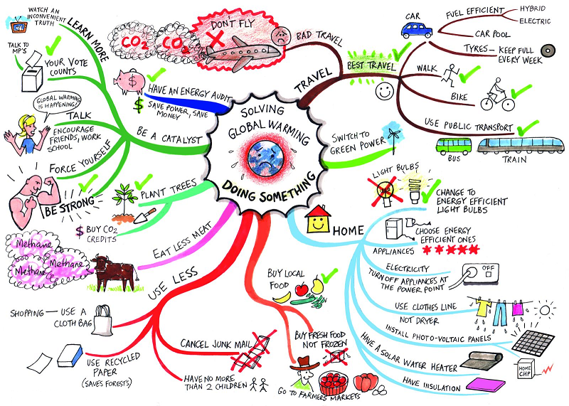
Documenting Techniques – Mind Maps
Investigate Situation
Notes:
bp99
A tool for summarising a lot of information in a simple visual form that highlights connections between different ideas and topics.

Slide 71
Exercise 4
Investigate Situation
Draw a mind map of the business analysis process model
Notes:
This is now optional and doesn’t appear in the delegate book, in case you wish to do your own thing.
We will add to this mind map at the end of each stage.

Slide 72
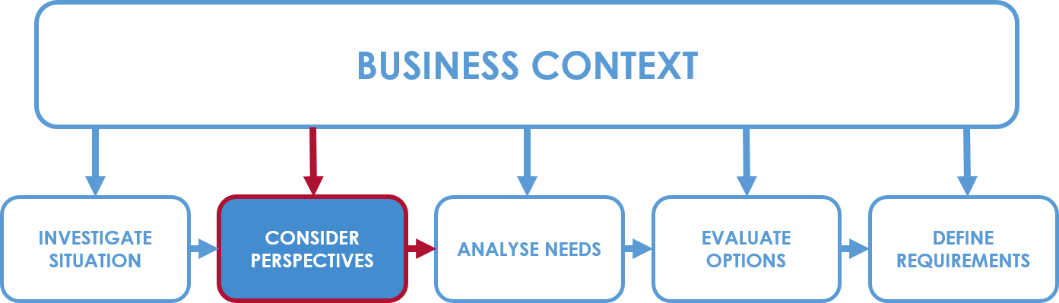
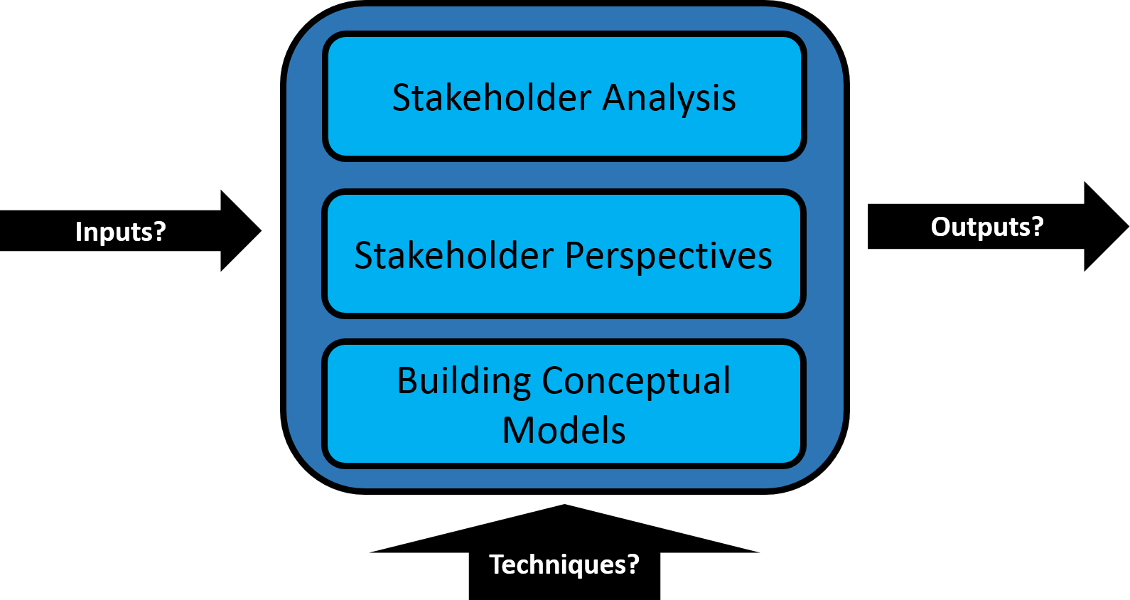
6. Stakeholder Analysis and Management
Consider Perspectives
Business Analysis Process Model : Consider Perspectives
Notes:
Ch6 pg 103
PART A to cover syllabus area 6.
Note that this section has been consolidated with CATWOE/BAM in the book and so there are now two parts to tie it to the existing syllabus (best way – sorry if this causes confusion)

Slide 73
Stakeholder Analysis and Management
Consider Perspectives
Stakeholder categories and identification
Analysing stakeholders
Stakeholder management strategies
Managing stakeholders for communication
Understanding stakeholder perspectives
Business activity models

Slide 74
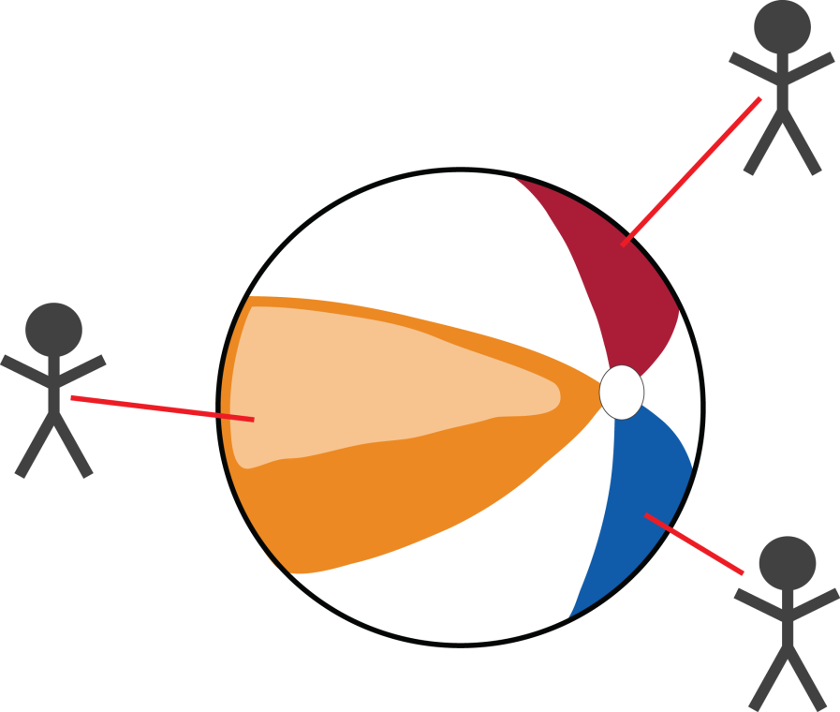
Stakeholder Analysis and Management
Consider Perspectives
Q: “What colour is the beach ball?”
“Red”
“Orange”
“Blue”

Slide 75
Stakeholder Identification
Consider Perspectives
Stakeholders are those who have an interest in, or may be affected by, the issue under consideration. They may be internal to an organisation or operate externally to the organisation.
Notes:
Bp103 - 104
Many change programmes fail because stakeholders are viewed as being internal only, but changes can affect suppliers, customers, local business, transport systems, etc. Partners are other organisations that provide services on our behalf, e.g. call centre services. Suppliers are other organisations that provide our organisation with the goods and services we need. Owners may be those who directly own the organisation or, as in the case of a plc, proxy owners such as fund managers in pension companies.

Slide 76
Stakeholder Management in the Project Lifecycle
Consider Perspectives
Devise stakeholder management strategies
Review/revise stakeholder management strategies
Identify stakeholders
Analyse stakeholders
Project initiation and inception
Project execution
Notes:
bp103

Slide 77
The Stakeholder Wheel
Consider Perspectives
Generic Stakeholder Categories
Partners
Suppliers
Regulators
Employees
Managers
Owners
Competitors
Customers
Notes:
Bp104 - 106
Partners: Other organisations that work with ours to deliver complementary or supplementary products and services
Suppliers: External organisations that provide products or services to our organisation
Regulators: External bodies that set and enforce regulations to which our organisation is subject
Employees: Operational staff who deliver our products or services
Managers: Senior and middle management who run the organisation, monitor progress and deliver results required by the owners
Owners: Depending on which sector our organisation is in, could include shareholders, trustees or government ministers
Competitors: Other organisations that deliver their version of products or services to the same target customers
Customers: Recipients of our organisations products or services

Slide 78
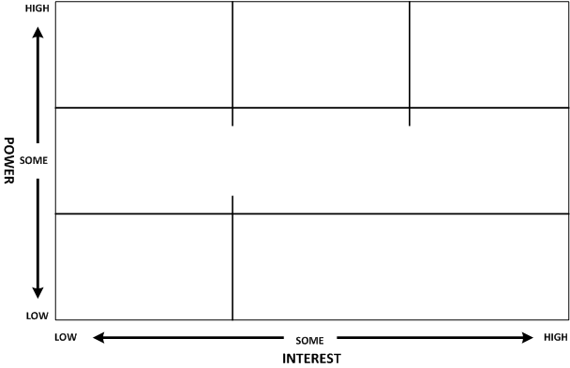
Analysing and Managing Stakeholders
Consider Perspectives
Stakeholder Power/Interest Grid (PIG)
Important to plot where they are, not where you want them to be
Helps to assess the effort needed to manage each stakeholder
No or low interest and high power/influence
Some interest and high power/influence
High interest and high power/influence
4. WATCH
5. KEEP SATISFIED
6. CONSTANT ACTIVE MANAGEMENT
No or low to high interest but some power/influence
3. KEEP ON-SIDE
No or low interest and no or low power/influence
Some or high interest and no or low power/influence
IGNORE
2. KEEP INFORMED
Notes:
Bp106 – 111
V3.2 Note that this slide now builds to incorporate the management strategies
Management strategies bit:
Used to help identify the communications strategy
Management strategies to be tailored for each

Slide 79
Stakeholder Attitudes
Consider Perspectives
Champion
Supporter
Neutral
Will actively work for the success of the project
Generally in favour but will not actively promote the project
Has expressed no opinion for or against
Opponent
Will obstruct progress, maybe for reasons outside the project
Critic
Not in favour but not actively opposed
Will actively work to disrupt or impede the project
Blocker
Notes:
Bp111, 112
You now need to know more about your key stakeholders. You need to know how they are likely to feel about and react to your project. If they are not likely to be positive, what will win them around to support your project? If this is not possible, how will you manage their opposition?

Slide 80
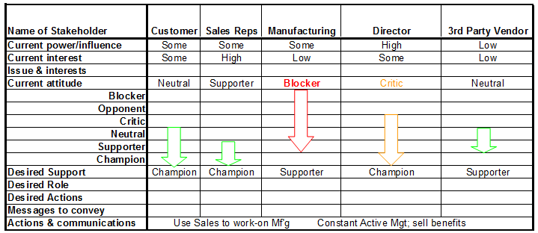
Managing Stakeholders
Consider Perspectives
Stakeholders will change during the project
A stakeholder plan is useful

Slide 81
Managing Stakeholders – Other Strategies
RACI or RASCI charts
Responsible
Accountable
(Support)
Consulted
Informed
Social media
Research on sites such as LinkedIn
Twitter and Facebook for communication

Slide 82
Exercise 5
Consider Perspectives
Stakeholder Analysis:
Identify the stakeholders from the scenario and plot them on a Power/Interest Grid
Notes:
If time delegates use post its and flipchart to do a stakeholder analysis of a training organisation, an organisation of their choosing or on the scenario

Slide 83
Understanding Stakeholder Perspectives
Consider Perspectives
Soft Systems Methodology (SSM)
Business perspectives (CATWOE)
Business activity models (BAM)
Contrasting perspectives
Activity threads
Notes:
Pg 115 - 120

Slide 84
Soft Systems Methodology
Consider Perspectives
Soft Systems Methodology (SSM) was created to help deal with systems that have high levels of uncertainty and complexity.
Created by Checkland and others
Based on a ‘learning for action’ approach
Example of a holistic, systemic approach
Stakeholders will have a different viewpoint of the situation and how it should be solved
IT has to fit into a ‘people’ situation
Having first class IT products is never enough
The context, culture and people issues in general must be understood and taken into account
If not, there is a real risk of failure
Notes:
bp115

Slide 85
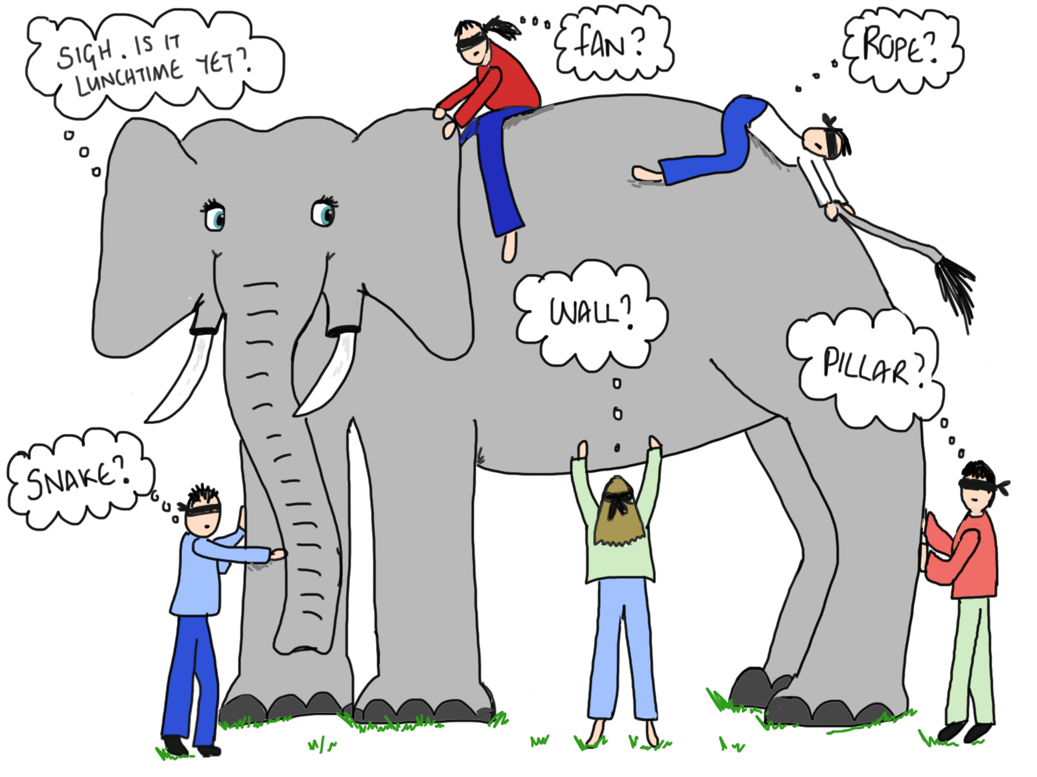
Understanding Stakeholders’ Perspectives
Consider Perspectives
Notes:
Represents the idea that without the full picture and all of the facts people could misinterpret/misrepresent what they perceive

Slide 86
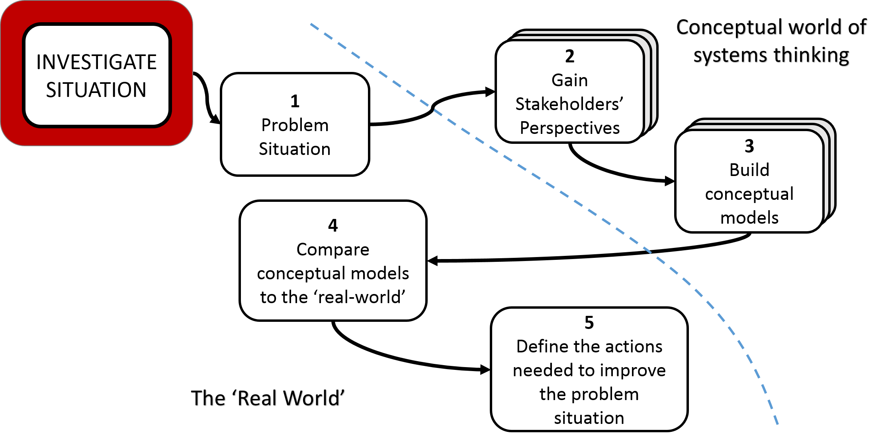

The 5 ‘Stages’ of SSM
Consider Perspectives
Notes:
bp115
SSM begins with an investigation into a real world situation of concern and Checkland proposed we use ‘rich picture’ to document it. The different ’world view’ of each stakeholders is then developed using a CATWOE and formalised as a sentence, known by Checkland as a ‘root definition’, but we prefer the term ‘business perspective’. From each business perspective a model of the stakeholder’s desired business system is produced, then the differences between these conceptual models are considered and the models are brought together in one consensus model, which represents the desired future system. This model is then compared to real world models, including the rich picture we produced earlier. By carrying out a gap analysis we can identify feasible, desirable changes that need to be made to the existing business system. This leads us to taking action to improve the problem situation, and could involve changes to the People, Organisation, Processes and Technology.
Note in the corner of the slide Wittgenstein’s duck rabbit – to show that individuals view the world differently – can you see both the duck and the rabbit?

Slide 87
CATWOE – Components of a Business Perspective
Consider Perspectives
Customer 3
Actors 4
Owner 5
Environment 6
The beneficiaries (occasionally victims!) of the transformation, the recipient of the outputs (goods or services)
Those responsible for performing the business activities included in the transformation
May include external business partners, e.g. distribution companies
Those who have authority to change or even stop the activities performed
The conditions / rules under which the business system must operate that are outside the control of the owner, e.g. PESTLE factors recognised by this stakeholder or fixed business policies
A short description of the highest level relevant business process (which takes inputs, adds value, and produces an output of value to the customer)
Transformation 2
The stakeholder’s beliefs / perspective of the world within which the organisation operates, that makes the Transformation meaningful . Weltanschauung.
Worldview 1
Notes:
bp116,117
The CATWOE Criteria are the basis of a business perspective:
C - Customer - the victims/ beneficiaries of the purposeful action
A - Actors – those who perform / will perform the activities. They may be internal to the organisation or external business partners
T - Transformation - the purposeful activity that transforms the input into an output of value to the customer
W - Worldview – An encapsulation of the stakeholder’s beliefs about the organisation or business system. Note that Checkland calls this “Weltanschauung”. Worldview or Weltanschauung is a declared, overall perspective of the system as a whole. This view determines, in part, how the system is to be considered. Components of a worldview often include values or what is good or bad, what is desirable or undesirable, what is interesting or not interesting, or what the (often assumed, but unstated) intended goals or objectives of a system are. For example, a prison may be viewed as a reform institute or a place of punishment. The view always depends upon the key player and problem owner making an observation about their perspective of the world.
O - Owner – person or group who can take major decisions about the business system
E - Environmental Factors – conditions and rules under which the business system must operate that are outside the control of the owner. Usually these will be the PESTLE factors recognised by this stakeholder, but internal business policies may be relevant if they are regarded as unchangeable.
The CATWOE criteria contain the elements considered when formulating definitions of a desired system. The business perspective describes the essence of the human activity to be modelled with a view toward exploring the problem situation as a basis for change.

Slide 88
A Business Perspective: the MD of Drive
W – Worldview
The manager of the vehicle rental business believes that future success for the business lies in the prestige side of the business: renting luxury vehicles, often long term, to wealthy customers spending time in multiple residences across the UK.
T – Transformation
Turning inputs into outputs; identifying self-drive customers and setting up contracts, delivering and collecting luxury vehicles for short term and long term
C – Customers
Customers seeking high quality, short to long term luxury vehicle hire. Customers wishing to hire prestige vehicles.
A – Actors
Customer Service Agents, Prestige Account Managers, Vehicle delivery and collection staff, vehicle maintenance team
O – Owner/s
MD of Drive
E – Environment
Tax and insurance on prestige vehicles, customer desire to rent long term, rather than purchase or use a chauffeur-driven service, concerns about the environment

Slide 89

Contrasting Perspectives
Individual business perspective
Differences in opinion
Provides a rounded view; a holistic view
Later on, these conflicts are considered through the activities they represent on the BAM
Ultimately, seeking consensus
Notes:
Pg 117
The process of learning about the problem through the stakeholder’s perspective is exactly how Checkland and his team expect this methodology to be most effective.
Delegates have an example of this on page 106 in their books

Slide 90
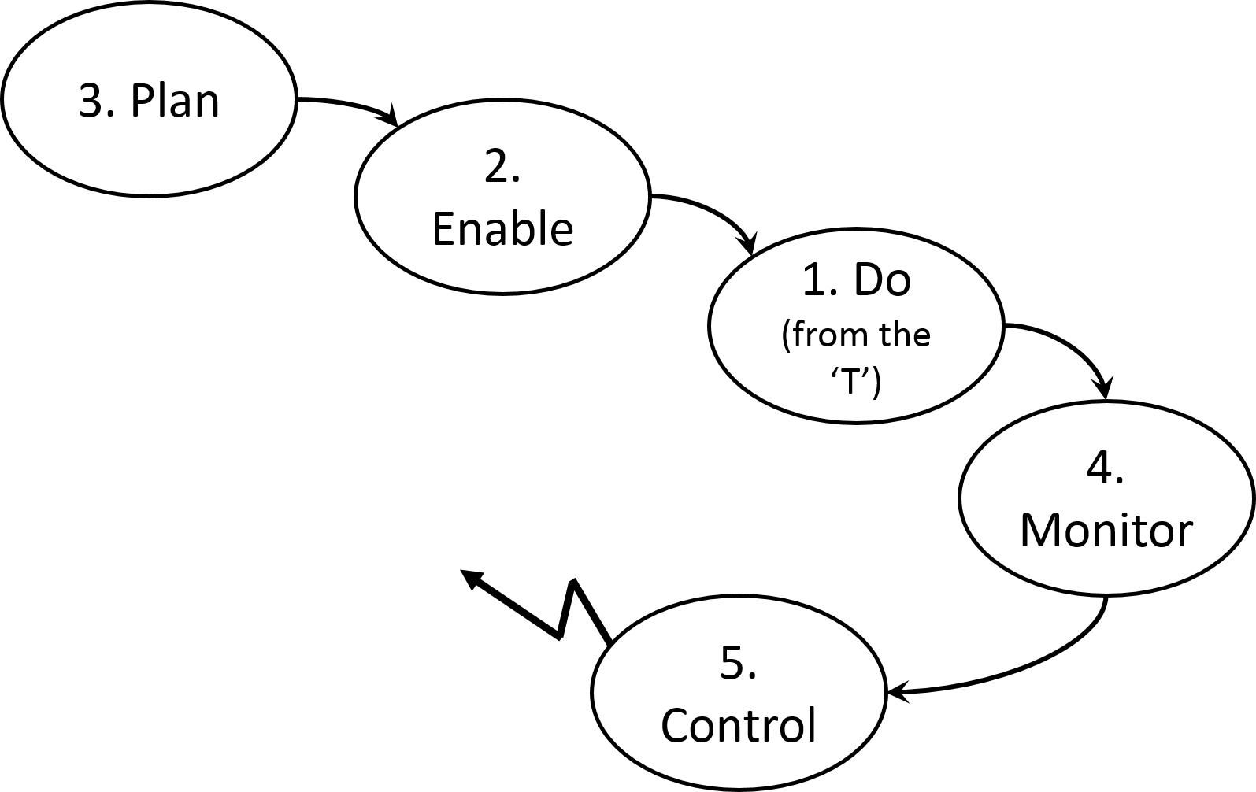
Illustrating the Perspectives: Business Activity Models
Consider Perspectives
A conceptual model
One for each business perspective
Overlaid to form a consensus model
Aids analysis and improvements
Does not show who carries out the activities or where they are carried out
Notes:
119
In the Business Activity Model, an arrow connecting two activities is a logical dependency.
It means "in order for the activity at the head of the arrow to be going on, the activity at the tail of the arrow must also be going on".
The arrow does not imply a trigger or an information flow (although, in some instances, that is what occurs in reality).
The ’Z' flows which do not point at other activities represent temporary dependencies on control activities - a control activity can affect any or all other activities within its scope in order that performance objectives are met.
Business planning activities
Resources, constraints and performance targets (for example, scheduling, capacity management, demand management, marketing)
Enabling activities
Things that need to be in place (for example, sales, recruitment, raw material, infrastructure)
Doing activities
Activities which transform inputs into outputs, 'primary task'
Monitoring activities
Performance measurement (KPIs), for example, customer satisfaction
Controlling activities
How the organisation is geared to take action if the performance expectations not met, audit, legal

Slide 91
Example: BAM From MD’s Perspective
Consider Perspectives
Research Customers
Define Staff Needs
Define Prestige Offering
Purchase Vehicles
Manage Catalogue
Recruit Staff
Train Staff
Maintain Vehicles
Collect Vehicle
Find Customers
Deliver Vehicle
Arrange Rental
Monitor Customer Feedback
Monitor Vehicle Condition
Set-up Contract
Take Control Action
Take Control Action
Notes:
A Business Activity Model is derived formally from its business perspective, and only from its business perspective. It should not include any real-world activities that are not represented in the business perspective.
In the Business Activity Model, an arrow connecting two activities is a logical dependency. It means "in order for the activity at the head of the arrow to be going on, the activity at the tail of the arrow must also be going on". The arrow does not imply a trigger or an information flow (although, in some instances, that is what occurs in reality).
The ’Z' flows which do not point at other activities represent temporary dependencies on control activities - a control activity can affect any or all other activities within its scope in order that performance objectives are met.

Slide 92
BAM: Next Steps
Consider Perspectives
Consolidated view of all stakeholder perspectives
Negotiations may be needed to reach agreement between stakeholders
Owner should be accountable
Consensus BAM
A model of what the system should look like and what it should be doing
Provides a basis for considering what opportunities exist for improvement
Can be further expanded to consider how the activities are or should be carried out
Notes:
Pg 120

Slide 93
BAM: Activity Threads
Consider Perspectives
Grouped ‘threads’ of related activity
Can help to identify process/people issues in the ‘real world’
The example shows the Prestige Scheme setup, recruitment and finalisation of the customer contract
Define Staff Needs
Define Prestige Offering
Recruit Staff
Train Staff
Find Customers
Set-up Contract

Slide 94
Exercise 6
Consider Perspectives
Modelling the business system:
CATWOE and BAM
Notes:
This may be done by the delegates or as a class exercise.

Slide 95
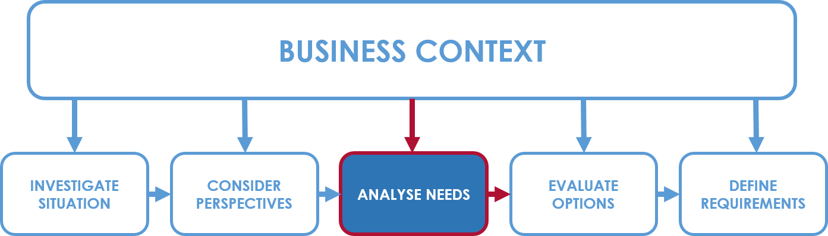
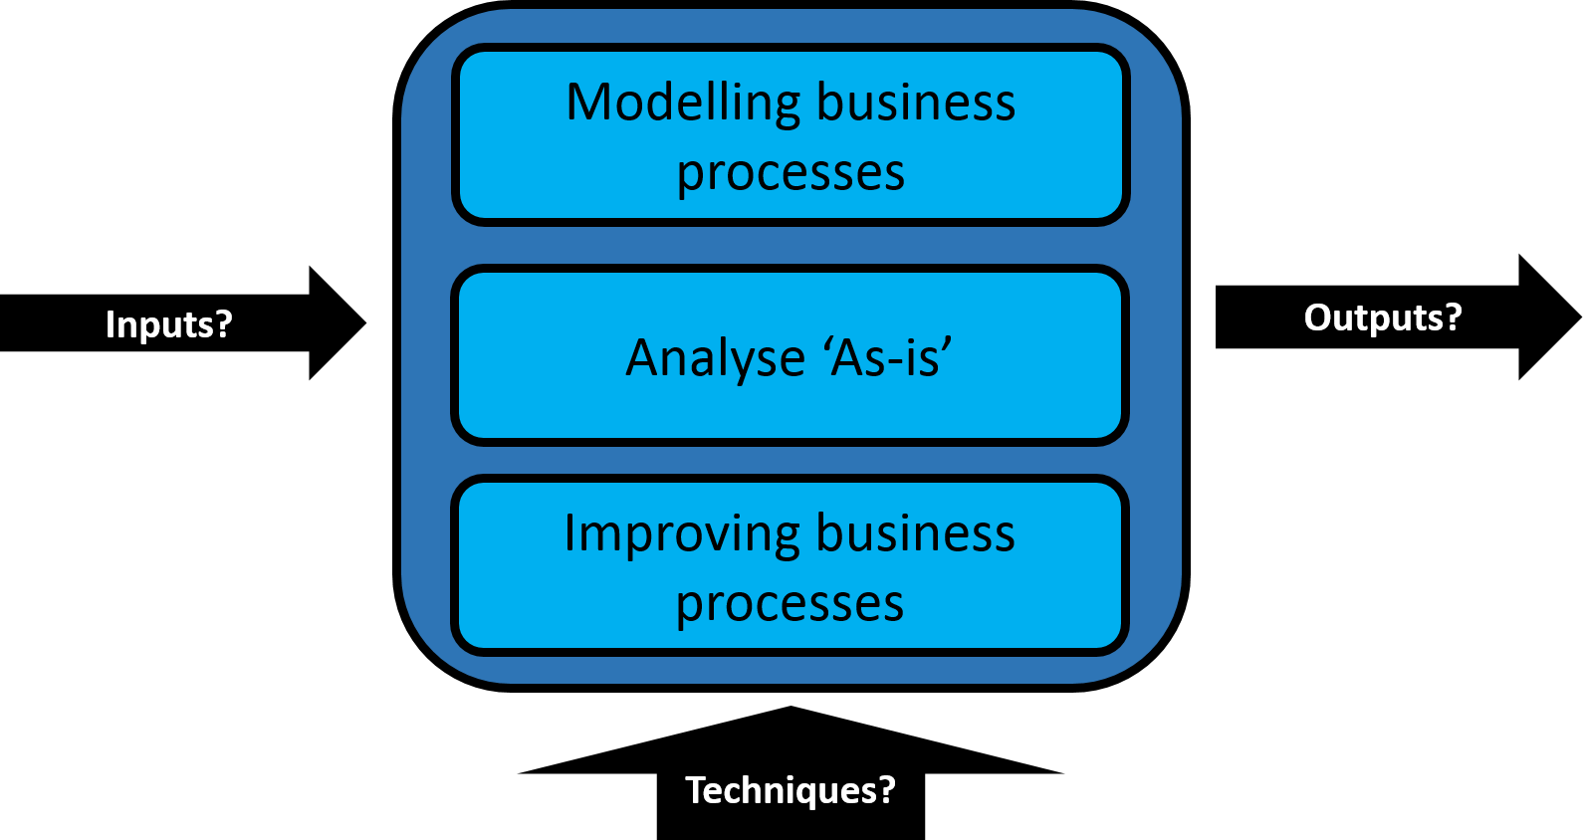
7. Modelling Business Processes
Analyse Needs
Business Analysis Process Model: Analyse Needs
Notes:
Ch7, p 123

Slide 96

Modelling Business Processes
Analyse Needs
Organisational context
An alternative view of an organisation
The organisational view of business processes
Value propositions and value chain
Business process models
Analysing the as-is business process model
Improving business processes
Notes:
Chapter 8, bp127

Slide 97
Organisational Context – Functional View
Management
Sales
Accounts
Logistics
Production
Analyse Needs
Fulfil Order
Processes can, and often do, transcend departmental / functional boundaries
Horizontal rather than vertical
‘Silo’ effect
The process view focuses on what we are in business to do, from our customer’s perspective
Notes:
bp124
A significant problem for businesses is process identity and above all process ownership. If sufficient care is not taken, the investment in improvements is localised to functional areas, and what seems to be an improvement in a part of the process may cause a deterioration in performance elsewhere.
Processes are independent of organisation structure – structure defines how the people in the business are organised to carry out the processes.
Essentially the business needs both views – i.e. A holistic view of process (e.g. using the process map) and a view of organisation structure.

Slide 98
An Alternative View of an Organisation
Analyse Needs
Organisation model (after Harmon 2007)
External environment
(Inputs and
resources)
The processes
(Outputs)
Customers
Suppliers
(Requests)
Competition
Notes:
bp125

Slide 99
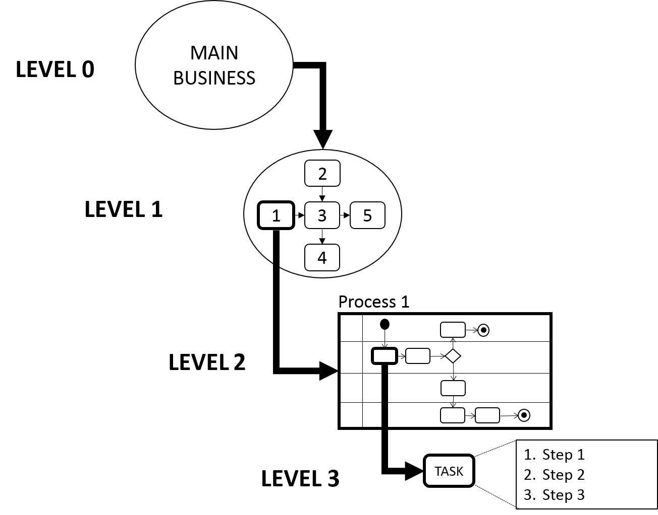
The (Conceptual) Process Hierarchy
Analyse Needs
Organisational or Process Map
Process Model (swimlane)
Task
Notes:
Pg 136

Slide 100
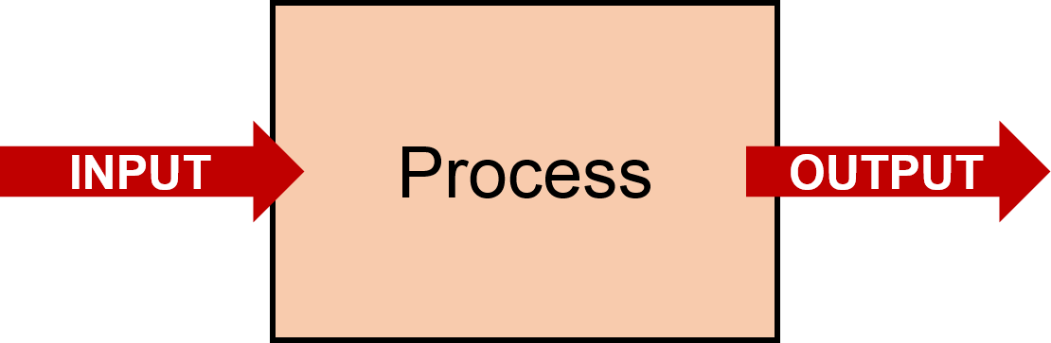
The Organisational View of Business Processes
Analyse Needs
“An organisational business process map is formed from a high-level set of activities carried out in order to deliver benefit or value to the customers.”
Shows dependencies between processes
Is a level above a process model
Notes:
Bp127
A map at this level is designed to show the interdependencies between the processes, rather than the flow of the process, tasks and actors which are shown in a Process Model

Slide 101
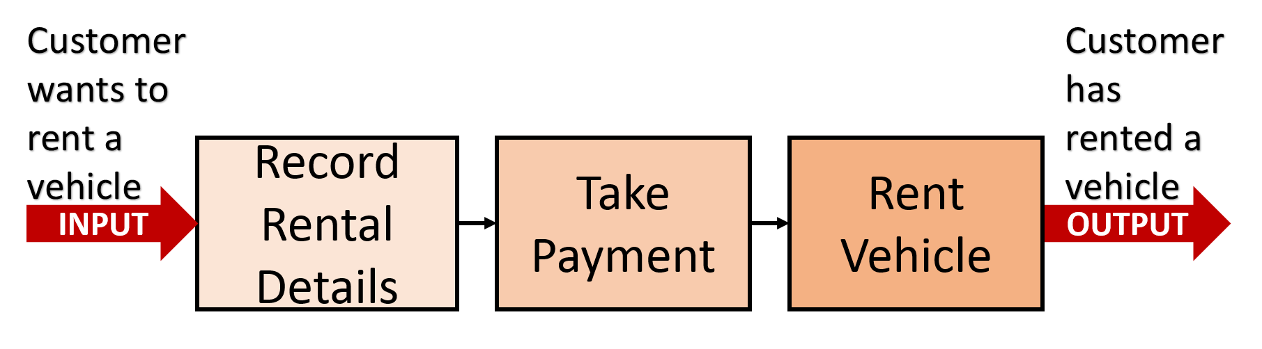
Outline Process Map
Analyse Needs
Shows a set of related processes in a single diagram
Notes:
bp127
Business process models (swimlane diagrams) show a more detailed view of the processes than on a process map
The process map can help us consider, before we get into the detail of the process itself, the boundaries of the process, i.e. where it begins and ends.
We can consider what the business needs to achieve to meet the needs of the customer and link the dependent processes together.

Slide 102
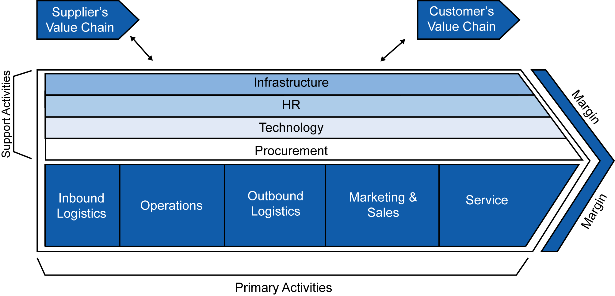
Porter’s Value Chain and Value System
Analyse Needs
Notes:
bp128
The Value Chain is an important model of business and supports the work of business analysis.
It helps analyse which activities are relevant to the value being created by the business for the customer and also serves as a concept to base the process map upon.
We also need to understand the value expected by the customer purchasing or using our products and services. This is where the value proposition comes in.
Primary Activities are those activities directly related to the production of the firm’s goods or services. Value Creation.
Support Activities help to improve the effectiveness or efficiency of Primary Activities. Enablers of Value Creation.
Essentially the Value Chain shows where costs are incurred by the organisation and where value is created for the Customer.
Porter extended the model to show that any organisation’s Value Chain is part of a Value System – a chain of Value Chains. This is also known as the External Value Chain, and in recent times, this has been depicted more as a Value Network.

Slide 103
Value Propositions
Analyse Needs
What is the value expected by our customer?
How do we differentiate from the competition?
Elements of the value proposition:
Product/service attributes
Functionality
Price
Quality
Choice
Availability
Image and reputation
Customer relationship
A value proposition is a definition of an organisation’s product or service that will demonstrate to customers that we understand and satisfy their needs.
Notes:
Bp129 - 131
A value proposition is a definition of an organisations’ product or service that will demonstrate to customers that we understand and can satisfy their needs.

Slide 104
Why Create Business Process Models?
Analyse Needs
To understand an as-is (or to-be) process
To communicate the inner workings of a process for training/knowledge purposes
To ensure consistency in the approach to each process or set of tasks and activities
To identify problems within existing processes
We refer to the existing business process model as the ‘As-Is’ and the improved process model as the ‘To-Be’
Notes:
Pg 123

Slide 105
Developing the Business Process Model
Analyse Needs
Drawn as ‘swimlanes’
A business process is triggered by a business event:
External
Internal
Scheduled
Includes 5 key components:
Tasks
Process flow
Decision points
Actors
Outcome of the process
Notes:
Bp132
Note that Business Process Model and Notation (BPMN) can provide an industry standard way of documenting process models

Slide 106
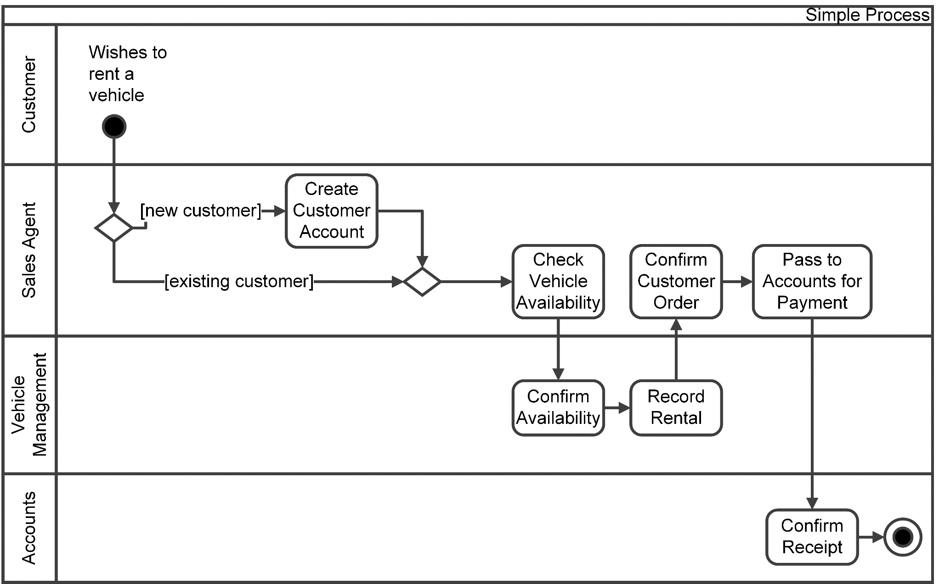
Example Process Model (Swimlane) Diagram
Analyse Needs
Notes:
bp137
The following conventions are used:
Process – an entire set of activities starting with a triggering event and ending with some output being delivered
Task – an activity within the process carried out by an actor/role at a single point of time
Step – activities within a task. Not usually shown on the business process model

Slide 107
Analysing the ‘As-is’ Process
Analyse Needs
Important to understand problems with the ‘as is’ process:
Analyse handoffs (cross-functional processes)
Analyse processing for:
Duplication
Redundancy
Lack of standardisation
Incompleteness
Inconsistent measurement or controls
Staff training (or lack thereof!)
Resource availability causing bottlenecks
Management of the process
What is the value added work?
Notes:
Bp138 - 141

Slide 108
Exercise 7
Analyse Needs
Analyse the business process. Where are there problems?
Notes:
Process model in workbook

Slide 109
Improving the ‘As-is’ Process
Analyse Needs
Improvements may involve:
Analysing the business rules
Constraints
Operational guidance
Simplifying process, removing bottlenecks
Extend the processing
Changing the sequence of tasks
Automating the process
Redefining process boundaries (start earlier; end later)
Redesign the process
Notes:
Bp138 - 144
Additional improvements added

Slide 110
Process Measurement
Analyse Needs
Considerations
Internal and external measures
Process and task measures
Performance issues
Six sigma – alternative approach to process improvement
Five step approach ‘DMAIC’
Notes:
Bp144 – 149
Define
Measure
Analyse
Improve
Control
A methodical and structured approach
Uses data and measurement to identify business benefit

Slide 111
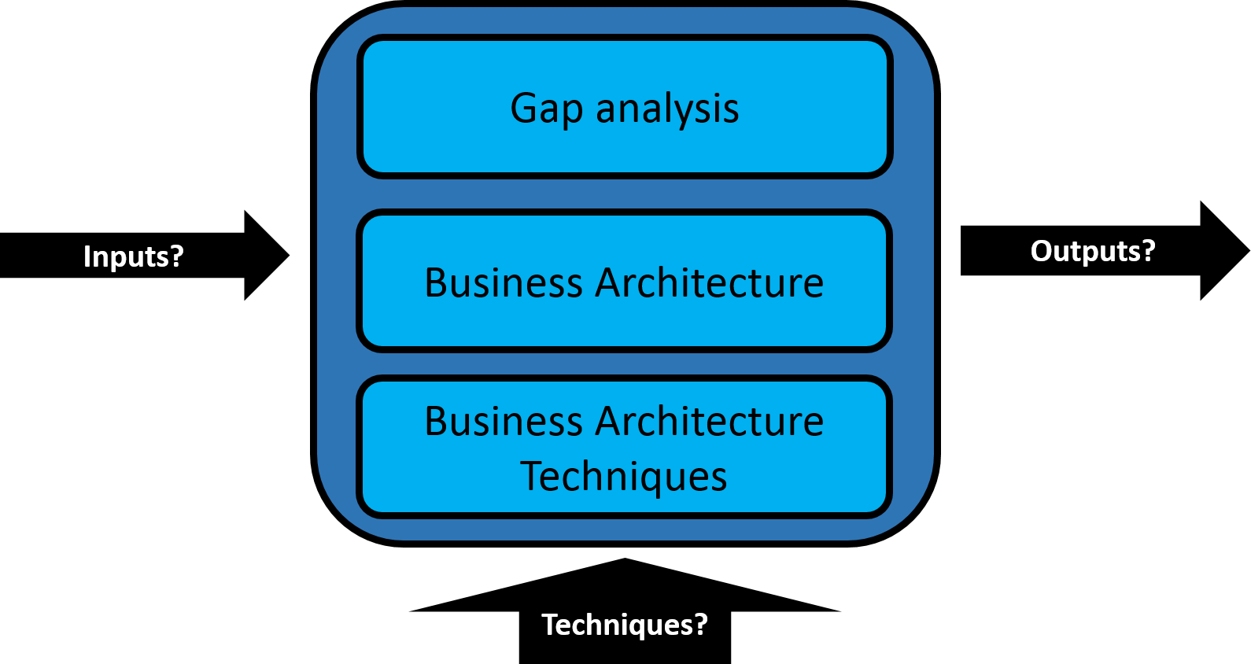
8. Defining the Solution
Analyse Needs
Business Analysis Process Model: Analyse Needs
Notes:
Chapter 8, pg 151

Slide 112
Gap Analysis
Analyse Needs
Explores the difference between the current state and the desired future state
BAM provides a conceptual view
Conceptual Desired Situation
Current state
Desired state
Notes:
Pg 151
Gap analysis can be used to compare the conceptual views of a business situation against the current as-is situation and identify the differences between them.
The differences give us the basis for defining the actions required to improve the business system. The BAM is one way that we can understand where the gaps exist.
Of course we shouldn't just rely on the BAMs to give us an idea of the required actions – we can also use as-is analysis using the results of our discussions with stakeholders, analysis of process models etc.
Can also compare ‘as is’ and ‘to be’ business process models, IT system requirements and skills gaps for desired roles

Slide 113
Identifying Areas of Concern (BAM)
Analyse Needs
Prioritise, using the BAM:
Do the desired activities exist?
P
O
Are they operating satisfactorily?
URGENT CONSIDERATION
O
P
Are there some issues to be addressed?
NO IMMEDIATE ACTION
P
O
ACTION REQUIRED
Notes:
CH8, Pp 151 – 152
The Business Activity Model can be used to categorise and identify areas for action.
The categorisation allows us to prioritise the work that we need to do and aligns with the objectives and scope for our Business Analysis work.
The gap analysis follows on from this work in investigating the ‘how’ and allows us to bring the activities identified as conceptual ‘shoulds’ back into reality.
The development of a Business Activity Model approaches the system from an entirely different viewpoint and allows the analyst to model the essential activities of the system without becoming too involved in the detail of what is actually going on. These two different views are both very useful and can be used to complement one another in the investigation of the system.

Slide 114
Frameworks for Gap Analysis
Analyse Needs
Holistic approach required to represent the situation
Change must be ‘real’
POPIT™
McKinsey’s 7-S model
Organisation
People
Information and Technology
Processes
Notes:
Pg 152 – 156
POPIT- allows us to consider all of the elements that the change will require
McKinsey’s 7-S model – Considers the organisational elements along with Structure and Culture considered in POPIT
.

Slide 115
Introduction to Business Architecture
Analyse Needs
Formal definition of the architecture of the business
Helps align business change proposal
Provides the holistic blueprint of business areas
Shows the interfaces, potential impacts and capabilities to deliver value
Can facilitate scenarios that determine:
Alignment
Impacts of change
Provides a bridge between the defined strategy and execution of strategy
Notes:
Pg 156 – 157
Business architecture tends to be shaped when two or more business areas begin to be seen to share capabilities with a common view, i.e. value delivery. These capabilities are integrated and standardised to promote effectiveness and often, efficiency.

Slide 116
Definition of Business Architecture
Analyse Needs
“A blueprint of the enterprise that provides a common understanding of the organisation that can be used to align strategic objectives and tactical demands"
The Business Architecture Guild (2014)
Notes:
Pg 157

Slide 117
Objectives of Business Architecture
Analyse Needs
Promote organisational health
Maintain longevity
Help fulfil unrealised opportunities
Considers and reacts to external influences
Aid organisational performance
Facilitate agile and flexible change
Identifies change benefits
Implements best practice
Focus on customer value
Re-use and metrics
Notes:
Pg 157
Key Points about Business Architecture
The scope of a business architecture is the scope of the business
It is not prescriptive
It is developed iteratively
It is reusable across the business
It is NOT about deliverables
Philosophy of the business
Values
A Business Architecture can document many ‘artefacts’ within it to provide multiple facets of the business, such as:
Capabilities (via the capability model)
Values (via the value stream)
Information
Products
Suppliers
Motivational aspects
Business units
Standards and policies
These together provide a multi layered, multi-dimensional view of the business. It is important to appreciate that all of the dependencies need to be considered and mapped back to the various artefacts that would define the Business Analysis activities.
The two most important Business Architecture techniques are:
Business capability modelling
Value stream analysis.

Slide 118
Business Architecture Techniques: Capability Model
Analyse Needs
Capability model
High level representation of what the organisation needs to do to deliver value to the customer
Capability = ability to achieve an outcome
Modelled as layers
Strategic
Core or customer facing (value-add)
Supporting
Notes:
Pg 159 – 160 – see pg 160 for an example of level 1 foundation capabilities

Slide 119
Business Architecture Techniques: Value Stream
Analyse Needs
Value Stream Analysis
An end-to-end collection of linear stages that create an outcome of value to a specified customer group
Could be the business customer or an internal customer of whatever value stream is being documented
Used to identify, map and analyse the value exchange
Value stream for the cinema experience
Purchase films
View schedule
Buy ticket
Purchase drinks and food
Enjoy
film
Film go-er
Notes:
Pg 161 - 162
Key points:
Stakeholder focused
Holistic view
Customer centric
High level (facilitate decomposition)
Help ID the business capabilities that will deliver customer value
Does not show who performs the stages
Can extend across multiple business units and/or organisations
Example is based on a value proposition as follows:
Watch films At Home. We provide comfortable sofas with a footrest, a surround sound screen, food and drink. You just turn up, and enjoy.

Slide 120
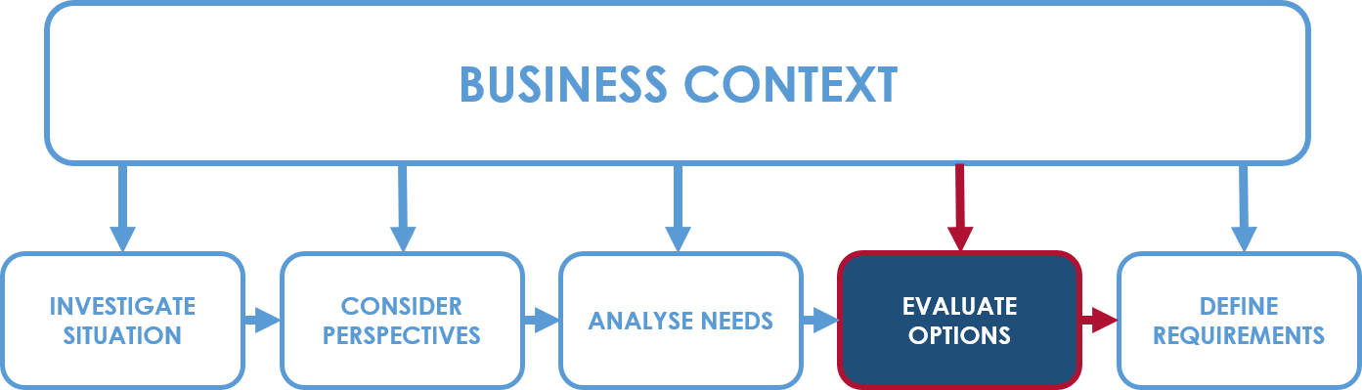
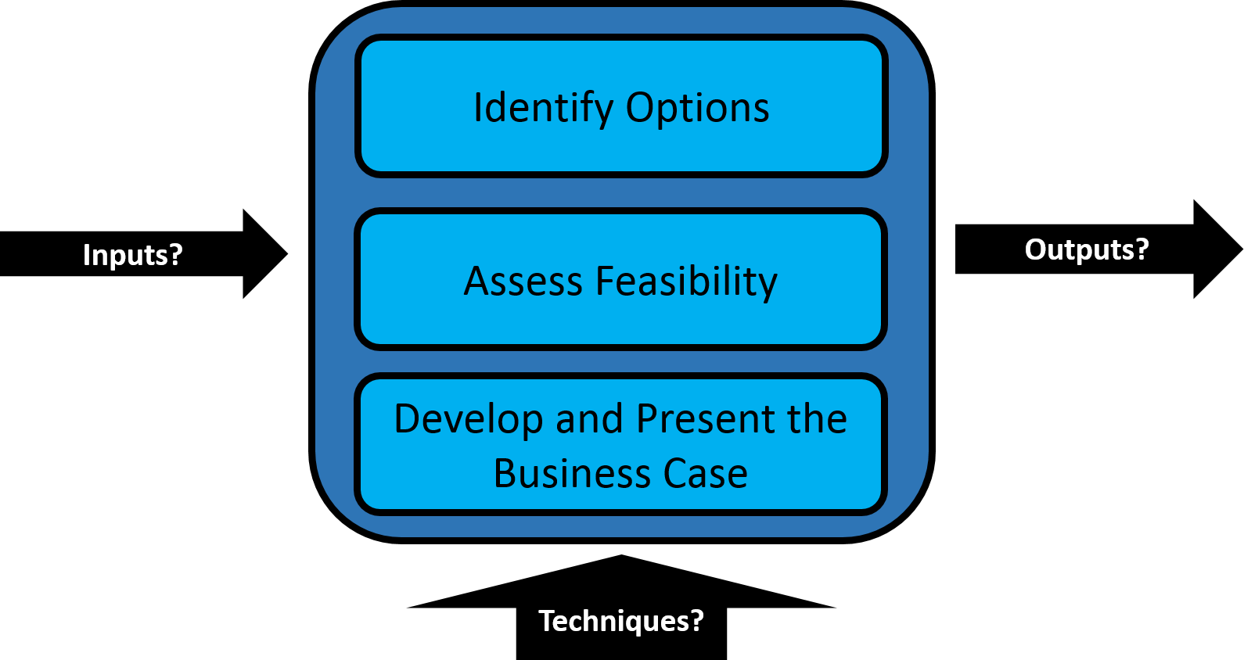
9. Making a Business and Financial Case
Evaluate Options
Business Analysis Process Model: Evaluate Options
Notes:
Chapter 9, p163

Slide 121

Making a Business and Financial Case
Evaluate Options
The business case in the project lifecycle
Identifying options
Assessing project feasibility
Structure of a business case
Investment appraisal

Slide 122
Business Case in the Project Lifecycle
Evaluate Options
Feasibility study
Requirements analysis and specification
Solution design
Solution development and implementation
Operation of new processes and systems
Initial business case before major resource commitment
Business case confirmed after detailed requirements
Business case confirmed once dev. costs estimated
Business case revisited before deployment
Benefits realisation checked
Notes:
Pg 163
Question often asked is when should the business case be produced…
Between each of the stages of the lifecycle shown there are “decision gates”, indicated by the dashed lines. Here the project should pass certain tests before being allowed to proceed to the next stage – in this case the tests relate to the business viability of the project.

Slide 123
Process for Developing Options
Evaluate Options
Identify possible options:
Business (WHAT)
Shortlist the options
Technical (HOW)
Take options forward to the Business Case
Financial?
Technical?
Business?
Evaluate the shortlist:
Notes:
Bp164 – 166
Can use BAM and BPM to establish options

Slide 124
Assessing Project Feasibility
Evaluate Options
Eliminate any options that are unacceptable because of…
Business
Strategic fit
Market conditions
Technical
Availability
Security
Financial
Budget
Funds available
Timeliness
Enterprise Architecture
Organisational ‘fit’
Cultural ‘fit’
Within competencies
Legality and regulation
Reliability
Maintainability
Performance
Technical skills
Compatibility
Proven
Borrowing available
Return on investment
Cash flow
Payback period
Scalability
Notes:
Pg 166
Slight amends to subjects
PESTLE can also be used

Slide 125
Other Analysis Tools
Evaluate Options
PESTLE
Force-field analysis (Kurt Lewin)
+ forces
- forces
Improve speed of production
Staff worried about change
2
3
Proposed solution
Customers want new product
3
£ Cost
4
Total: 5
Total: 7
Notes:
bp168

Slide 126
Structure of a Business Case
Evaluate Options
Introduction
Management summary
Description of the current situation
I.e. The “Do Nothing” option
Options considered
Analysis of costs and benefits
Impact and Risk assessment
Recommendations
Appendices and supporting information
Justifies the project
Notes:
Bp168 – 169

Slide 127
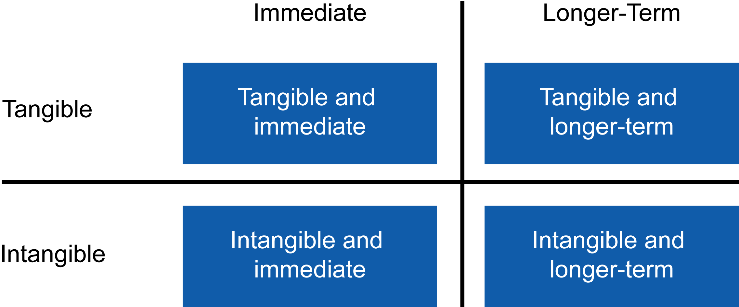
Categories of Costs and Benefits
Evaluate Options
Notes:
bp170

Slide 128
Tangible Costs and Benefits
Evaluate Options
Costs
One-off and Ongoing
Development staff costs
Benefits
Reduced effort and improved speed of working
Faster responses
Reduced accommodation costs
User staff costs
Equipment
Infrastructure
Packaged software
Relocation
Staff training and retraining
Ongoing costs
Staff savings
Reduced inventory
Other costs
Reduced overtime
Reduced travel costs
Reduced consumable costs
Avoided costs
Notes:
Bp171 - 173
Tangible costs and benefits are those for which we have a specific basis for measurement, usually financial. For the benefits we would need to have taken a measurement before the project starts so that we have a basis for comparison.
One-off (initial) costs
New hardware
Infrastructure
Software packages
Development staff costs
User staff costs
User training
Redundancy
Relocation
Data clean up / migration
Ongoing costs
Hardware maintenance
Software support
Salaries for additional staff
Increased premises costs
Increased inventory
Increased consumables costs
Increased travel / transport costs

Slide 129
Intangible Costs and Benefits
Evaluate Options
Costs
Disruption and short-term loss of productivity
Benefits
Increased job satisfaction
Improved customer satisfaction
Better management information
Greater organisational flexibility
More problem-solving time
Improved presentation or better market image
Recruitment and induction
Better communications
Notes:
Bp171 - 173
Most of the costs will be tangible, but we must not overlook the ones it is hard to measure. For the benefits, it is important not to overstate the intangibles or put spurious values on them; it is best to identify them and allow the decision makers to place their own value on them.

Slide 130
Impact and Risk Assessment
Evaluate Options
IMPACT: for each option, what changes will have to be made?
Organisation structure
Interdepartmental relations
Working practices
Management style
Recruitment policy
Appraisal and promotion criteria
Supplier relations
RISK: the risks of the change should be identified
Description of the risk
Impact assessment
Probability (likelihood)
Countermeasures
Ownership
Notes:
bp174

Slide 131
Investment Appraisal
Evaluate Options
In this part of the business case the financial aspects are compared to understand if and when the project will pay for itself
Investment appraisal techniques:
Payback calculation
Discounted Cash Flow (DCF)
Internal Rate of Return (IRR)
Net Present Value (NPV)

Slide 132
Payback Calculation
Evaluate Options
Item | Year 0 | Year 1 | Year 2 | Year 3 | Year 4
Hardware purchase | -180,000 | 0 | 0 | 0 | 0
Hardware maintenance | 0 | -30,000 | -30,000 | -30,000 | -30,000
Software purchase | -80,000 | 0 | 0 | 0 | 0
Software support | 0 | -30,000 | -30,000 | -30,000 | -30,000
Staff savings | 0 | 150,000 | 150,000 | 150,000 | 150,000
Cash flow for year (savings less costs) | -260,000 | 90,000 | 90,000 | 90,000 | 90,000
Cumulative cash flow | -260,000 | -170,000 | -80,000 | 10,000 | 100,000
Notes:
Pg 176
Hardware purchase, Hardware maintenance, Software purchases and Software support are all costs. Figures are shown -250,00 or (250,000).
Staff savings are a benefit – Figures are shown 150,000.
Total costs – total savings = Cash flow. In year 1 the costs outweigh the benefits and the cash flow is -£260,00. From year 2 onwards the benefits exceed the costs by £90,000.
By accumulating the cash flow we can discover when the accumulated benefits finally exceed the accumulated costs. This is known as the payback period.
What is the payback period?
Payback calculations are easy to understand , but take no account of the ‘time value of money’.

Slide 133
Discounted Cash Flow, Net Present Value and IRR
Evaluate Options
Item | Year 0 | Year 1 | Year 2 | Year 3 | Year 4
Cash flow for year (savings less costs) | -260,000 | 90,000 | 90,000 | 90,000 | 90,000
Discount Factor (10%) | 1.000 | 0.909 | 0.826 | 0.751 | 0.683
DCF | -260,000 | 81,810 | 74,340 | 67,590 | 61,470
Cumulative DCF | -260,000 | -178,190 | -103,850 | -36,260 | +25,210
Net Present Value (NPV) of the project = £25,210 after 4 years (add all DCF)
Internal Rate of Return (IRR)
Assesses what sort of return on investment is represented by the project as a single percentage figure
Compared against the likely interest rates over the same period
Notes:
bp177
To take account of the time value of money we use discounted cash flow. Management accountants provide a discount factor to apply to the cash flow.
This discount factor takes account of likely money-market interest rate changes over the duration of the project.
The Discounted Cash Flows (DCF) are accumulated to give a Net Present Value (NPV) for the project.
NPV is calculated for each option in the Business Case so that they can be compared.
IRR is a calculation that assesses what sort of return on investment is represented by the project in terms of a single percentage figure
IRR – the rate of return, as a single percentage figure, a project is expected to generate.
To calculate IRR work back from NPV = 0 at a fixed point in the future e.g. 5 years, to calculate the % discount rate that would have been applied to achieve NPV = 0.
The IRR is compared for the options in the Business Case – BUT this calculation does not take account of the size of the investment in each option.

Slide 134
Exercise 8
Evaluate Options
Calculate the payback period
Notes:
Payback calculation

Slide 135
Presentation of a Business Case
Evaluate Options
Think about the audience
Keep it short
Consider the structure
Think about appearances
Consider ongoing reporting (and communication)
RAID logs
CARDI logs
Notes:
Bp179
RAID – Risk, Assumptions, Issues, Dependencies
CARDI – Constraints, Assumptions, Risk, Dependencies, Issues

Slide 136
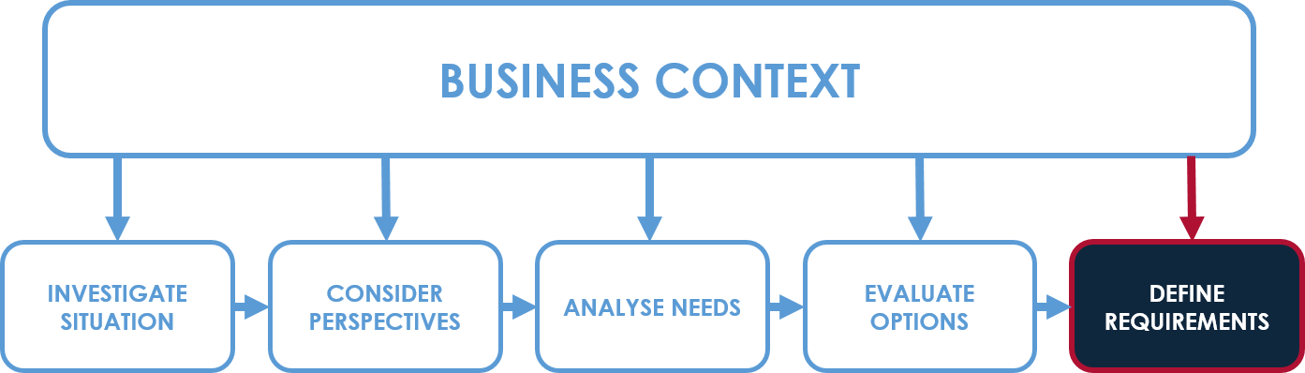
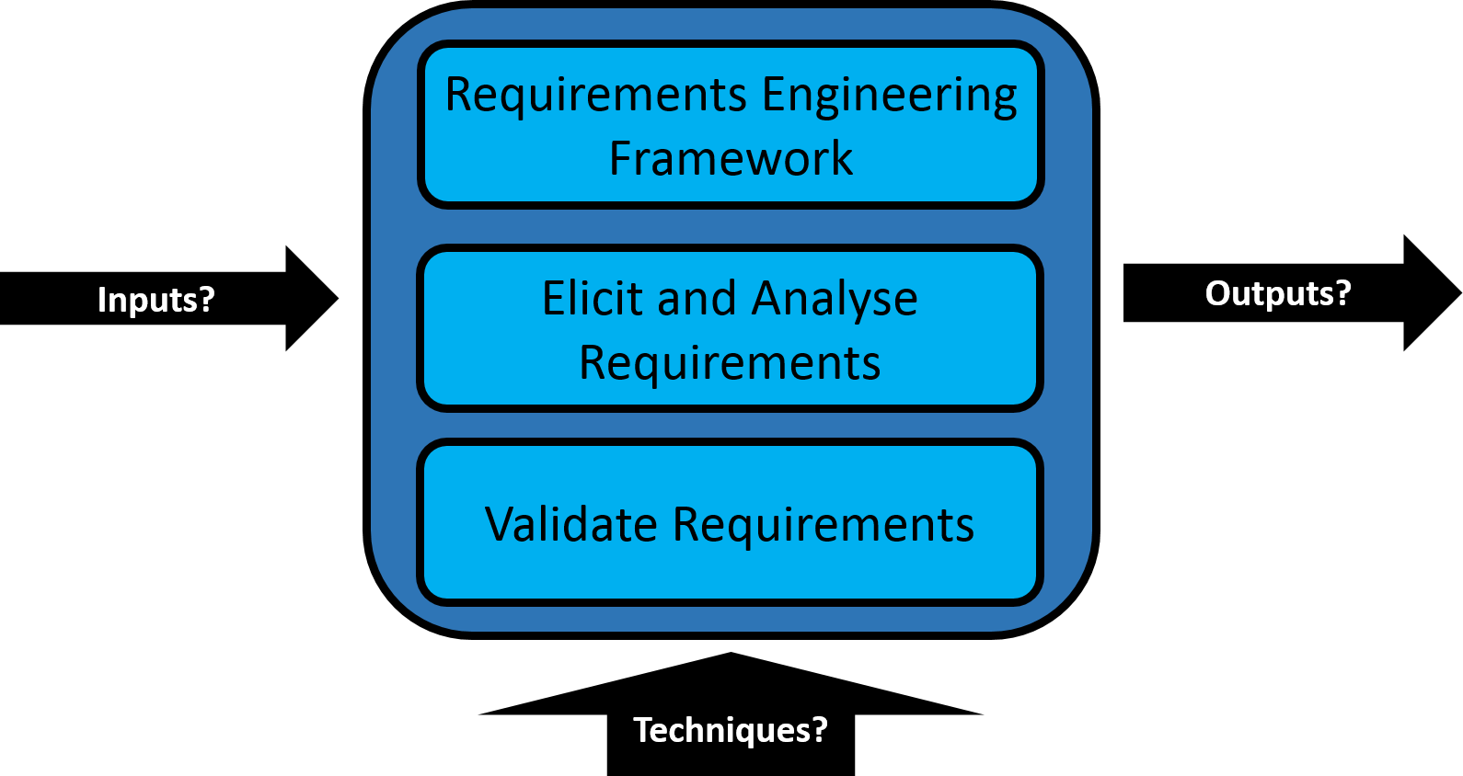
10. Establishing the Requirements
Define Requirements
Business Analysis Process Model: Define Requirements
Notes:
Chapter 10, pg 181

Slide 137
Requirements Engineering
Define Requirements
Problems with requirements
A framework for requirements engineering
Actors in requirements engineering
Requirements elicitation
Requirements analysis
Validating requirements
Notes:
Bp181
Note that this has been separated to manage elicite and analyse first, followed by document and validate

Slide 138
Problems with Requirements
Define Requirements
Not linked to business objectives in terms of reference (OSCAR)
With how they are written:
Ambiguity
Duplication and overlaps
Conflicts between requirements
No measures of success or quality
Assume a solution
Assume understanding of terminology
With how they are captured:
Requirements missing/incomplete/incorrect
Misinterpreted from the stakeholder
Lack of understanding of stakeholder perspectives
Notes:
Bp182 - 184
Objectives
Scope
Constraints
Authority
Resources

Slide 139
Requirements Engineering Framework
Define Requirements
Requirements
elicitation
Requirements analysis
Requirements validation
Requirements documentation
Requirements management
Notes:
bp185
These are the components of requirements engineering.

Slide 140
Actors in Requirements Engineering
Define Requirements
The business representatives
Project sponsor
Subject Matter Expert (SME)
Business users
The project team
Project manager
Business analysts
Developers/Technical Architects
Project Office and Software Testers
Notes:
Bp186 – 188
Project Sponsor
Responsibilities (agree the PID, deliver the benefits etc.)
SME
Risks (culture, politics, resentment, knowledge transfer)
Project Office and Testers – might just be communication based. Depending on the project needs

Slide 141
Requirements Elicitation
Define Requirements
Drawing out requirements and visualising possibilities
Knowledge types are significant when talking to stakeholders and eliciting requirements
Tacit knowledge
Difficult to articulate
Unspoken knowledge
Explicit knowledge
Written down
Shareable
I know what I know. Don’t I?
Notes:
Bp 191 – 193
Also the different types of knowledge
Tacit vs. explicit knowledge
Individual
Corporate

Slide 142
Requirements Elicitation Techniques
Define Requirements
Interviews, workshops
AERO
Apprentice
Shadowing
Protocol analysis
Enact
Prototype
Scenario role-play
Recount
Storytelling
Scenarios
Observe
Observation
Once elicited it needs to be recorded
Notes:
Pg 191 - 193

Slide 143
Building the Requirements List
Define Requirements
Initial (informal) list of requirements
Requirements analysis
Requirements catalogue
Validate and control
Documents everything raised and origin
Notes:
Bp193 - 195

Slide 144
Requirements Analysis Tasks
Define Requirements
Categorisation of requirements
First pass (detail in chapter 11):
Aids validation and stakeholder ownership
Modelling (chapter 12)
Reflect the elicited requirements
Check for completeness and understanding
Filtering
Ensuring the requirements are well formed
Categories
General?
Technical?
Functional?
Non-functional?
Notes:
Bp196
‘Requirements are related to each other. Some general and technical requirements refer to business policies that are elaborated and expanded in the functional and non-functional requirements.’ from Business Analysis by Paul, Yeates and Cadle.

Slide 145
Requirements Analysis: Filtering
Define Requirements
Requirements filters?
Outcome
Accept
Reword
Merge
Split
Clarify with business
Finally, check are the requirements well formed and
SMART(Specific, Measurable, Achievable, Relevant ,Time-framed)
Priority, relevance & feasibility
Overlaps & conflicts
Ambiguity & testability
Well formed requirements
Notes:
Bp196 – 200
Have a look at page 199 in the book for examples of requirements analysis using table 10.3 on page 194
Overlapping, duplicate, conflicting
Multiple
Necessity and feasibility
Solution
Confirm quality

Slide 146
Requirements Validation
Define Requirements
Review group
Business sponsor
Business (requirements) owners
Subject matter expert
Developers
Testers
Project Office Representatives
Outcome
‘Signed off’ (baselined)
Some amendments, sign off by chairperson
Significant rework, review again
Notes:
Bp200, 201

Slide 147
Agile Approach
Define Requirements
Reduction in maintenance overheads
Removes redundancy in up front requirements specification
Scope creep a real possibility
Bigger picture can be lost
Traceability can be compromised
P
O
Notes:
Pg 202 – 204
RE approach can be time consuming
Agile approach is about evolutionary requirements
Still needs a starting point
Timeboxed requirements set
Follow the RE approach to ensure well-formed requirements

Slide 148
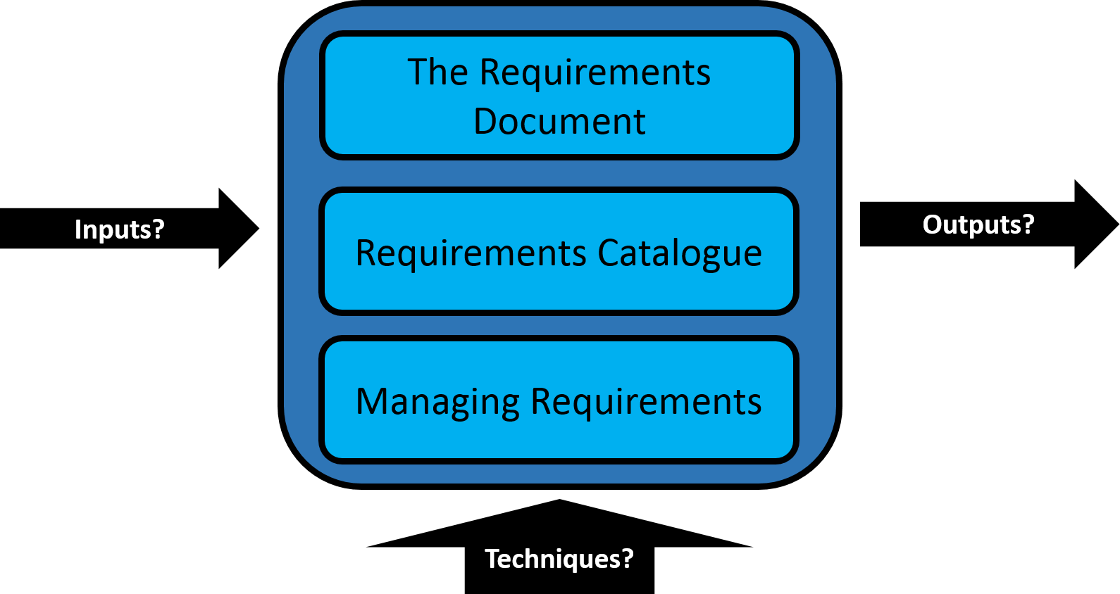
11. Documenting and Managing Requirements
Define Requirements
Business Analysis Process Model: Define Requirements
Notes:
Pg 205

Slide 149
The Requirements Document
Define Requirements
Why document?
Enables communication within the project team
Provides a basis for validation with the stakeholders and requirements owners
Input for changes and impact analysis
Used for testing and implementation
Notes:
205

Slide 150
The Requirements Document: Structure
Define Requirements
Requirements Document
Introduction and background
Business process models
Glossary of terms
Function models
Data model
Requirements catalogue
Notes:
205 – 207
Business process models → ‘to-be’
Function models → context diagrams, use cases
Data models → ERD, data class models

Slide 151
Requirements Catalogue
Define Requirements
Types of requirement
BUSINESS
SOLUTION
General
Functional
Technical
Non-functional
Notes:
Bp207 - 213

Slide 152
General Requirements
Define Requirements
Requirements that define business policies, standards and needs
Broad scope
Business constraints
Budget, timescale, resources etc.
Business policies
Standards, business rules
Legal
Legislative and regulatory constraints
Branding
Image, style guide
Cultural
Vision, approach, management style etc.
Language
If operating across international boundaries
Notes:
Pg 208, 209
Note that Business Continuity has been removed and added to nfr

Slide 153
Technical Requirements
Define Requirements
Requirements that state technical policies and constraints
Organisation wide
Hardware
Software
Interoperability
Internet
IT and other hardware
Operating systems, package applications, networking, communications etc.
Standards for communicating between systems and devices
Policies on Internet use and web services
Notes:
Pg 209 – 210
Note that Interface has changed to Interoperability

Slide 154
Functional Requirements
Define Requirements
Requirements that define the features the solution should provide
Often relate to data capture, manipulation or reporting (CRUD)
Data entry
Data maintenance
Procedural
Retrieval requirements
Gathering and recording data (CREATE)
Changes to data, including data deletion (UPDATE and DELETE)
Implementation of business rules
Reporting, responding to enquiries (READ)
Notes:
210 – 211
Functional requirements must be implementable and testable

Slide 155
Functional Requirements: examples
Define Requirements
The system shall:
Generate a unique customer account number for new records
Hold customer name
Hold customer address
Hold customer credit limit
Hold customer date of first order
Allow changes to be made to customer details
Report on all orders placed in the last week
Allow customer orders to be searched by customer account number or name

Slide 156
Non-functional Requirements
Define Requirements
Requirements that define how well the solution will operate
Performance
Security
Access
Backup & recovery
Archiving & retention
Maintainability
Availability
Usability
Capacity
Speed of processing transactions
Security levels for protection of data
Permissions, who has access to which functionality and how
Protection against loss of data
Duration, methods, eventual deletion
Timeframe for availability of functionality
Ease of learning, ease of use
Data volumes, transaction volumes, user volumes
Includes servicing, problem detection and correction
Accessibility
Usability: enabling access for all
Business Continuity
Disaster recovery
Notes:
Pg 211 – 213
Note the addition of Accessibility
Must be implementable and testable
Major factors in the cost of the product

Slide 157
Non-functional Requirements examples
Define Requirements
The system must be able to respond to 10,000 enquiries per day
This is a Capacity requirement
Reprint the report on demand
This is an Availability requirement
Respond to an enquiry on available customer credit within 5 seconds
This is a Performance requirement
Archive customer records after 7 years
This is an Archiving and Retention requirement
Images shall be compatible for screen readers
This is an Accessibility requirement
Notes:
A useful definition of non functional requirements is being ‘concerned with the performance and level of operation of the system. In other words how well the system will perform in certain areas’. They are a major factor in the cost of the project.

Slide 158
Hierarchy of Requirements
Define Requirements
Requirements are related to one another
Should also be related to the organisation’s values, strategy and objectives
Feasibility, and therefore prioritisation
Also helps assess timescales and necessity of a requirement
Notes:
A useful definition of non functional requirements is being ‘concerned with the performance and level of operation of the system. In other words how well the system will perform in certain areas’. They are a major factor in the cost of the project.
E.g.:
The accessibility requirement ‘Images must be compatible for screen readers’ is related to the general requirement that all web pages must meet accessibility level AA
Note that accessibility level AA as defined in the WCAG is a priority for developers and in v1.0 was defined as ‘Priority 2: Web developers should satisfy these requirements, otherwise some groups will find it difficult to access the Web content. Conformance to this level is described as AA or Double-A.’ See W3 website for further information: http://www.w3.org/

Slide 159
Documenting a Requirement
Define Requirements
Author Anna Liszt | Date 02/08/2014 | Version 0.1 |  | Status In development |  |  | Business Area Reception
Requirement Identifier |  | F-102v0.1 |  |  |  | Version History |  | 1st draft
Requirement Name |  | Check in unreserved customer
Requirement Description |  | Receptionist must be able to check in a customer who has no reservation, providing a suitable room is available
Requirement Type |  | Functional
Acceptance Criteria |  | Client checked in, only if suitable room(s) available for those nights
Source |  | B. Welcome, Receptionist
Owner |  | I. Snoop, Duty Manager
Priority |  | Must | Rationale |  | 10% of hotel bookings are walk-in, value £200k p.a.
Associated NFRs |  | N-88 Must be possible to enter all data and confirm room(s) within 3 minutes, N-001 Access Permissions
Related Documents |  | Interview notes B. Welcome 26/07/2014
Notes:
Note an example has been added to the book, in appendix 11a, pg 223

Slide 160
Prioritising Requirements (MoSCoW)
Define Requirements
It is important to prioritise requirements:
It allows the staging of requirement implementation
It enables the management of user expectations
M – must have
Mandatory in the first increment; cannot meet objectives without it
S – should have
Mandatory but may wait until second increment; the system will have short-term value without it
C – could have
Beneficial if time or funds allow, but not central to project objectives
W – want to have (won’t have this time)
Will not be met in this delivery; may be upgraded in a future delivery
Notes:
bp215
The priority is not assigned when the requirement is first captured, but later on during negotiation. MoSCoW is used by DSDM Atern and many lifecycles
All requirements should be prioritised and the priorities should be used to focus the analysis, negotiation, implementation and test. It is pointless expending energy and resources on a requirement that is merely cosmetic as opposed to one having massive business impact. Note that the priority of requirements may change over time as conflicts are resolved and the descriptions are tightened. Stakeholders must be involved in prioritising requirements and later in requirements validation to ensure that their expectations of the IT system are realistic

Slide 161
Managing Requirements
Define Requirements
Requirements identification
Requirements cross-referencing
Requirements origin and ownership
Software support (CASE/CARE)
Change control
Configuration Management
Configuration management in Agile
Notes:
Bp218 - 222
Managing requirements
Recording requirements documentation
Change control
Version control
Traceability
Computer Aided Software Engineering (CASE) tools
Computer Aided Requirements Engineering (CARE) tools

Slide 162
Exercise 9
Define Requirements
MoSCoW
for the Cinema Website Requirements
Notes:
UPDATE
Group activity – prioritise the requirements from the case study

Slide 163
12. Modelling Requirements
Define Requirements
Modelling system functions
Entity Relationship Diagrams
Modelling system data
Class Models
Use Case Diagrams
Notes:
Chapter 12, Modelling Requirements, pg 224

Slide 164
UML – Unified Modelling Language
Define Requirements
Only need a grasp of the basics to communicate
Used by technical teams
Used to clarify understanding
There are many UML models. Examples are:
Use Case Diagram – function view
Class Model – data view

Slide 165
Types of Use Case Diagram
Define Requirements
Business Use Cases
Shows the usage that stakeholders require from a system
Useful for scoping, gaining an overview of the business areas
Not focused on an IT system
System Use Cases
‘one picture is worth ten thousand words’
Shows the functions that actors require from the IT system, a ‘case of use’
Notes:
Pg 224

Slide 166

Use Case Diagram Levels
Define Requirements
Context Diagram
Sales Team
Workshop Supervisor
Use Case Description
Use Case Diagram
Rent Vehicle
Display vehicle list
Select vehicle
Display available dates
Select start date
Select duration…
……………..
Rent Vehicle
Record Inspection
Record Return
Sales Team
Workshop Supervisor
Notes:
Bp225
Context diagram – black box: shows the main interactions only
Use Case diagram – more detail. Shows the functions
UC Desc – scenario

Slide 167
Define Requirements
Example Use Case Diagram
System Boundary
Vehicle Rental System
Association
Rent Vehicle
<<actor>>
Payment System
Record Inspection
<<actor>>
9am
Workshop Supervisor
Sales Team
Record Return
<<time>>
9am
Actor
Use Case
Notes:
Pg 225
Use Case:
Something an ‘actor’ wants the system to do
Each business activity has at least one use case, which is a sequence of actions for achieving certain objectives within the business activity

Slide 168
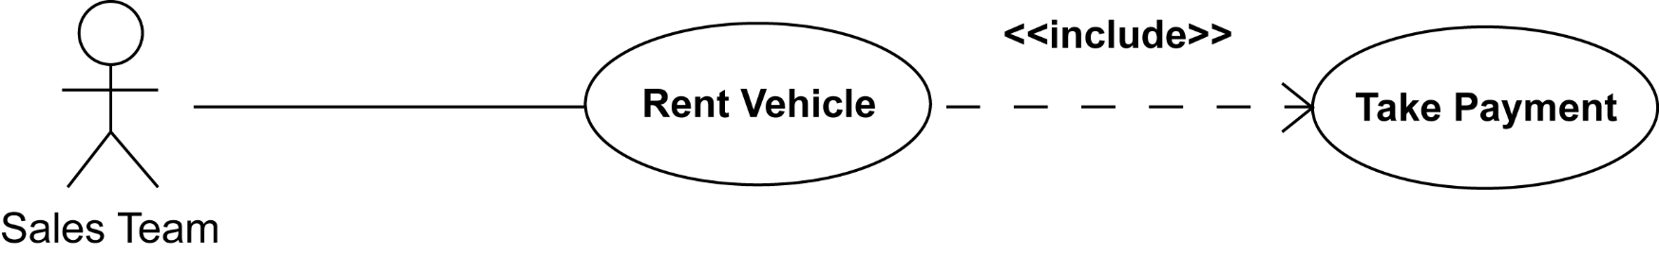
<<include>> Relationship
Define Requirements
The <<include>> relationship
indicates that the rent vehicle use case includes the functionality of the take payment use case
It has the sense that this functionality is always (unconditionally) included
Allows repeat use of functionality
Notes:
bp227

Slide 169
Use Case Diagram with <<include>>
Define Requirements
Vehicle Rental System
Record Inspection
Rent Vehicle
<<include>>
Take Payment
Workshop Supervisor
Sales Team
Record Return

Slide 170
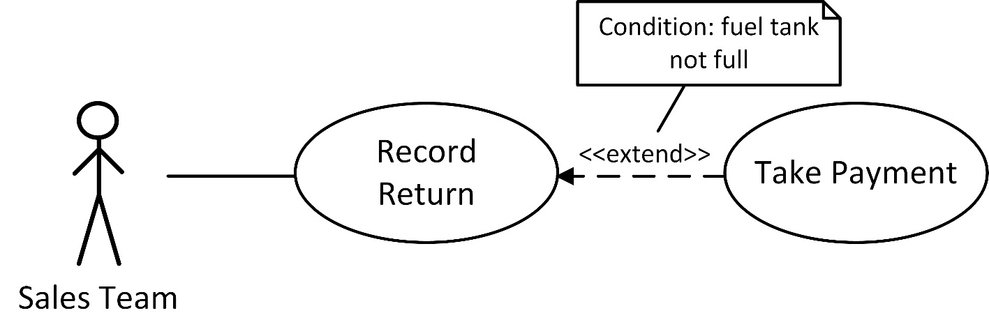
<<extend>> Relationship
Define Requirements
The <<extend>> relationship
indicates that one use case has its functionality extended by the functionality of another
This extension occurs under certain conditions:
Record Return may be extended by the functionality of Take Payment if the customer has not filled the fuel tank
Notes:
bp228
The extension takes place at one or more specific extension points defined in the extended use case. The behaviour of the extending use case is considered to be inserted into the extended use case. The extended use case is defined independently of the extending use case and is meaningful independently of the extending use case. Note that the same extending use case can extend more than one use case.

Slide 171
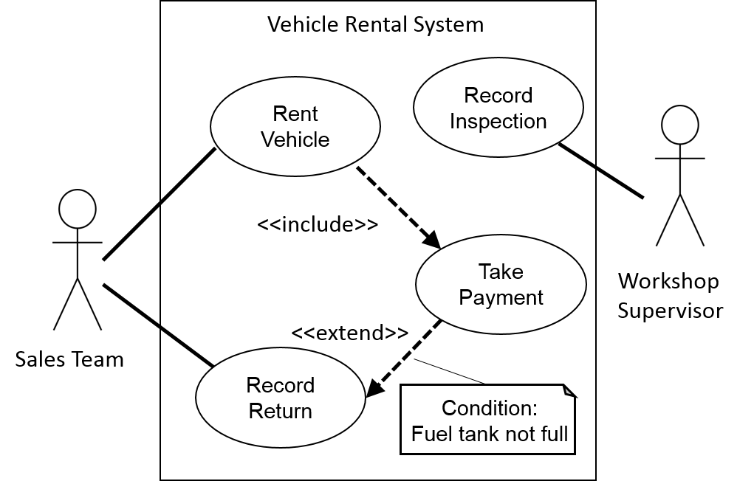
Use Case Diagram Complete
Define Requirements

Slide 172
Modelling Data: Entity Relationship Diagrams
Define Requirements
Entity:
Something (noun) the business wants to collect and store data about
Physical (e.g. order, customer, supplier)
Conceptual (e.g. course booking, appointment)
Active (e.g. meeting, course delivery)
Identifies the data that needs to be stored, attributes
Entity occurrences must be uniquely identifiable
Shows relationships between entities
Used during database design
Notes:
229

Slide 173
Entity Relationship Diagram Elements
Define Requirements
Entity occurrence
Entity
Attributes
Relationship degree between entities
ID
Customer
Customer A
Name
Customer
Customer B
Company
Order
Sales Person
Customer C
Order Item
Product
Notes:
bp230

Slide 174
Relationship Degree
Define Requirements
“One to one”
Employee
manages
Department
Each employee manages one department
Each department is managed by one employee
“One to many”
places
Customer
Sales order
Each customer places many sales orders
Each sales order is placed by one customer
“Many to many”
Course
is attended by
Delegate
Each course is attended by many delegates
Each delegate attends many courses
Notes:
230 - 237

Slide 175
Resolving Many-to-Many Relationships
Define Requirements
is attended by
Course
Delegate
Key: Course code
Key: Delegate number
In which entity type do you put the attribute
“exam result”?
Course
Delegate
Course
attendance
Compound Key: Course code/delegate number
Course Attendance attributes:
Course date attended
Venue
Exam result… etc.
Notes:
bp234
Many: many relationships are found on logical data models. They must be resolved to produce a physical data model.
Sometimes it is okay to use a compound entity name as well as a compound key e.g. course/delegate, but often a ‘business’ name will be available and will be better.

Slide 176
Relationship Optionality
Define Requirements
Mandatory relationship
Conditional relationship
Order
This MUST have 1 or many of these
Customer
This MIGHT have 1 or many of these,
but these MUST belong to this
Order Item
Order
Conditional relationship
Fully optional relationship
Complaint
Customer Call
This MIGHT have 1 or many of these,
which MIGHT have one of this
This MUST have 1 or many of these,
but these MIGHT not have one of this
Order
Order
Notes:
Bp 232 – 233
Analysed slightly differently.
The one end is the parent end and the many end the child.
A customer may not have placed any orders yet but an order must have a customer
A complaint must be related to an order but an order may not have a complaint

Slide 177
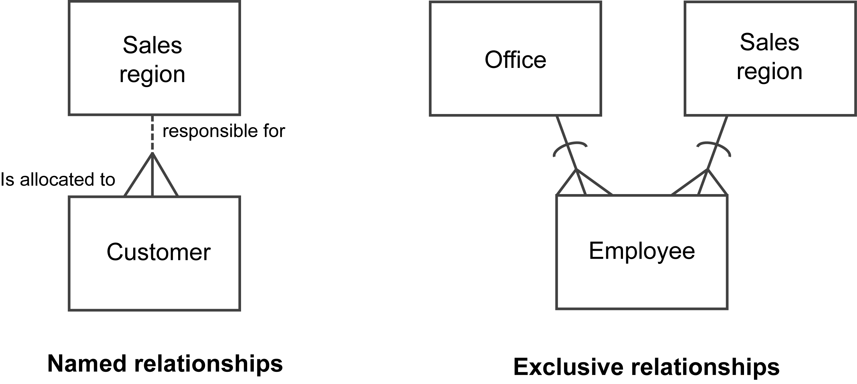
Entity Relationship Diagram – Further Notation
Define Requirements
Notes:
Bp235 - 236
Relationships should be named – usually in both directions.
Exclusive relationship – each employee must be allocated to one and only one sales region, or to one and only one office

Slide 178
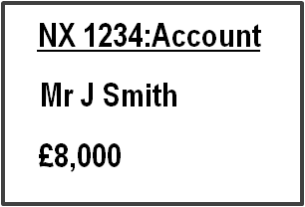
Modelling Class Data – Class Models
Define Requirements
Class: a generic definition of the data items e.g. ‘Account’
(similar to entities or Tables in a database)
Attributes: something we want to hold data about e.g. ‘Account number’, ‘Name’ and ‘Credit Limit’
(similar to a Field or column in a database)
Operations: What the class will do when the operation is ‘called’. Attributes are only accessible to the operations listed (encapsulation)
Object: an instance of the Account Class
(similar to a specific record in a database)
Account
accountNumber
name
creditLimit
createAccount
updateCreditLimit
Notes:
Bp237 - 239

Slide 179
Class Diagram Elements
Define Requirements
Class
Associations between classes
Object
Attributes
Customer
ID
Customer A
Name
1..1
Customer
Customer B
Company
Attributes
Customer C
Multiplicity
Operations
0..*
The action that the class will take when a message is received to invoke the operation
Order
Notes:
bp230

Slide 180
Class Model Notation (1)
Define Requirements
Class name
Attributes
Associations with notation at each end indicating the multiplicity
Common multiplicities are:
0..1 No instances, or one instance (optional, may)
1..1 Exactly one instance (or ‘1’)
0..* Zero or more instances (or ‘*’)
1..* One or more instances (at least one)
Used to implement business rules
2..12 A course delivery has a minimum of 2 and maximum of 12 delegates
Order
Customer
1
0..* 1..1
Notes:
Bp240
Class name – capitalise first initial
Attributes – lower case with constituent parts shown with capitalised initials
Associations with notation at each end indicating the multiplicity of instances per class

Slide 181
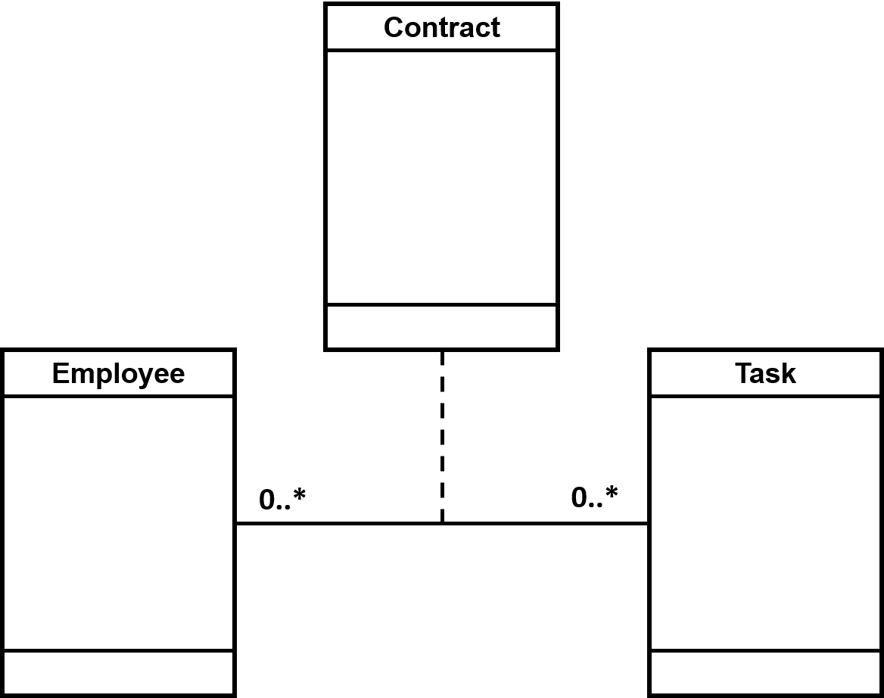
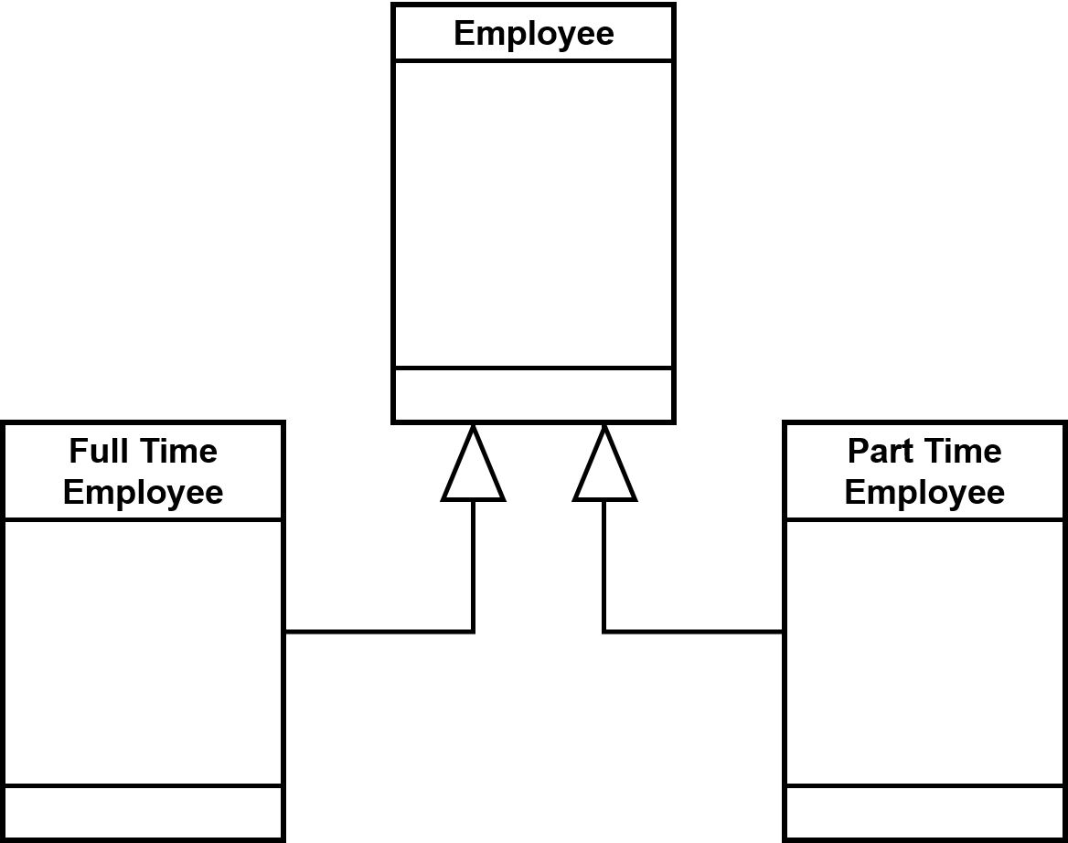
Class Model Notation (2)
Define Requirements
Association classes
Resolve many to many
Generalisation
Data is common to sub-classes
Notes:
bp242

Slide 182
Exercise 10
Define Requirements
IT system modelling
Notes:
UPDATE
Group activity – prioritise the requirements from the case study

Slide 183
13. Delivering the Requirements
Delivering the solution
Context for the delivery approach
Delivery lifecycles
Notes:
Chapter 13, pg 246

Slide 184
Delivering the Solution
Factors in deciding the delivery approach
Context
Lifecycle
Approach
Roles
Deliverables
+
+
+
Techniques
Notes:
bp247

Slide 185
Delivering the Solution
Factors in deciding the delivery approach
The nature of the organisation and project that will provide the basis for deciding how the solution will be delivered
Adopted process for delivery
Methods and standards
Who will be involved
Products being delivered
+
+
+
The management and development techniques used to plan, analyse and document the project work
Notes:
bp247

Slide 186

Lifecycle for Business Change
s
e
Notes:
Pg 248

Slide 187
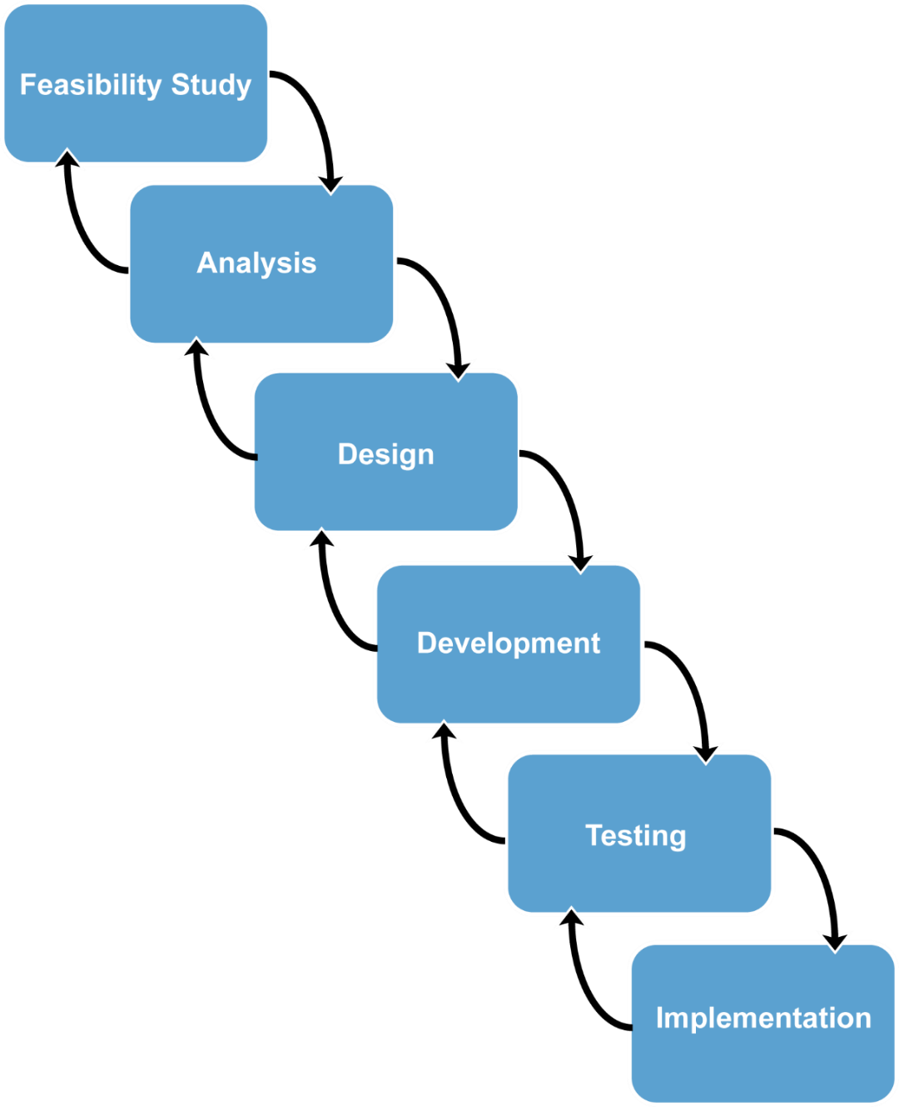
Waterfall Lifecycle
Earliest Software Development Lifecycle
Linear
Each stage reviewed and signed off before the next can begin
High level of control
P
May not be able to elicit all requirements
Requirements can get outdated quickly
O
Notes:
bp249
This is the traditional approach to systems development. Unfortunately it does not allow for early testing as no thought is given to testing until all of the development is done.
It consists of the following sequential phases:
1.Feasibility - project initiation. Define Terms Of Reference (TOR). High-level investigation and estimates. Preliminary exploration of problems and possible solutions. Benefits versus costs of candidate solutions. Recommendation of one option. This is where the business analyst is involved.
2.Analysis. Investigate, document and assess current system. Gather and document new requirements. Requirements documentation produced and signed off.
3. Design. High-level design of the system including database design and user interface design , followed by detailed design when program specifications are produced.
4.Build.and test. Perform detailed technical design. Decompose specifications further into units or components. Specify these components. Code and test components. Components are brought together to form higher level systems and tested.
5.Implementation. Train staff, user acceptance testing, handover
6. Review. Post implementation review of project and system
Business analysts would typically be involved in the feasibility study and analysis.
Waterfall can be adapted for a package solution. After analysis phase, acquire and configure software package instead of design and build.
SSADM is an example of a traditional waterfall methodology
The backwards facing arrows indicate the need to check back at each stage, to ensure the project stays in scope, that each stage builds logically on its predecessor and modifications to deliverables from a previous stage may be made.

Slide 188
The V-model
Analyse business needs
Business
case
Review benefits
Acceptance criteria
Review benefits
Define requirements
Ensure user acceptance
Define solution
System test criteria
Test solution
Develop solution
Unit test
criteria
Test modules
In the shaded box is considered the main scope of the business analyst
Notes:
bp250
The V model is basically a waterfall model which explicitly shows the connection between the development stages of the project and the later testing phases. In the variation of it shown above the initial work concerns analysing the business needs and developing the business case that justifies the recommended solution. This is the domain of the BA who is involved with defining the options in the business case and supporting the business in doing the UAT amongst other things

Slide 189
Incremental Delivery
Analysis and design completed up front
Development divided into discrete phases
Product decomposed into components
Evolutionary
Develop
Feasibility Study
Test
Analysis
Implement
Increment 1
Design
Develop
Test
Implement
Increment 2
Notes:
Pg 252
The incremental model is a method of software development where the model is designed, implemented and tested incrementally (a little more is added each time) until the product is finished. It involves both development and maintenance. The product is defined as finished when it satisfies all of its requirements. This model combines the elements of the waterfall model with the iterative philosophy of prototyping.
The product is decomposed into a number of components, each of which are designed and built separately (termed as builds). Each component is delivered to the client when it is complete. This allows partial utilization of the product and avoids a long development time. It provides the user with earlier use of some of the system functionality and avoids a large initial capital outlay with the subsequent long wait for the IT system. This model of development also helps ease the traumatic effect of introducing a completely new system all at once. There are, overall, few problems with this model.
Allows frequent reassessment of scope, requirements and solutions.
The basic idea behind this approach is to develop a system incrementally, allowing the developer to take advantage of what was learned during the development of earlier, incremental, deliverable versions of the system.
Learning comes from both the development and use of the system, where possible.
Analysis and design completed up front
Development divided into discrete phases
Planned
Targeted deliverables
Product decomposed into components
Components are designed, built and tested separately
Integration testing of components can be complex
Evolutionary

Slide 190

Iterative Systems Development
Useful when complete set of requirements not possible upfront
Governed by fundamental principles:
Evolutionary
Empowerment and collaboration
Fit for purpose
Test all the time
Re-factoring
Incremental delivery
Prioritisation – e.g. MoSCoW
Time-boxing
Notes:
bp253
Iterative or evolutionary systems development may be used when a complete set of requirements cannot be gathered at the start of the project. This approach allows requirements to be gathered iteratively. Prototypes are demonstrated to the business user, feedback captures and further requirements built into the next prototype. The system is delivered once, after a number of iterations .

Slide 191
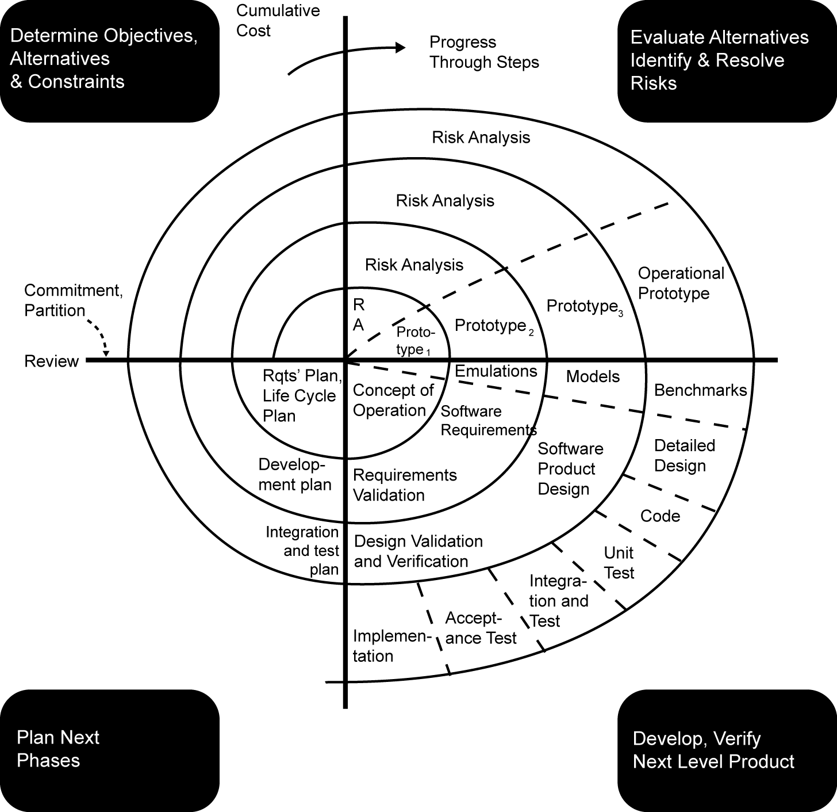
Boehm’s Spiral Model – Example of Iterative Systems Development

Slide 192

Development and Delivery Approach
How do we work?
How will we deliver the solution?
Software development approaches
The importance of prioritisation
Software package approach – COTS
Roles, deliverables and techniques chosen
Notes:
Bp256 – 262
Software development approaches:
Structured - Unified process (UP) - UML
Iterative - Agile – DSDM Atern, Scrum (sprints)
The importance of prioritisation
Software package approach – COTS
Roles, deliverables and techniques of the project depend upon:
The organisation and project context
The lifecycle
The approach

Slide 193
14. Delivering the Business Solution
BA role in the business change lifecycle
Design stage
Implementation stage
Realisation stage
Notes:
Chapter 14, bp264
Write with your non-dominant hand ‘managing change can be difficult’. How did that feel?

Slide 194
Lifecycle for Business Change
Alignment
of business in a changing environment
Definition
plan human dimension of change
Design
business processes, specifications, development and testing
Implementation
planning and preparation for deployment into BaU
Realisation
ensure planned change has taken place and benefits achieved
Notes:
Pg 264 - 265

Slide 195
The Role of the BA in the Business Change Lifecycle
Business Analyst involved with change:
Throughout:
From inception to implementation
At the Design Stage
Active, constant involvement
For the Implementation Stage:
Planning and execution of the change
For Realisation:
Planning for success
Notes:
Pg 265 – 266
Next slides cover Design, Implementation and Realisation

Slide 196
Involvement in the Design Stage
POPIT™ model useful to consider all areas
People?
Organisation?
Process design?
Information and Technology?
O
P
IT
P
Notes:
Pg 265
The design stage is likely to be where the BA has the most involvement in the project.
Implementation will be where the changes are made real (and therefore the BA is accountable for them as the project moves towards this stage)
People – skills?
Organisation – structures, measurement and reporting, jobs?
Process design – implementation?
Information and Technology – designing, developing and testing the solution?

Slide 197
Information and Technology – Role of the BA
Design
Requirements ‘Gatekeeper’
Development
Impact Analysis
Business Representative
Testing
Use Case Descriptions
Decision tables and business rules
State Machine Diagrams (status changes to data for example)
Notes:
Pg 267 – 268
Design, development and testing of the solution

Slide 198
Involvement in the Implementation Stage
Business Analyst involvement to:
Plan
Ensure that change is carefully executed
Understand and lessen emotional impacts
Measurement and monitoring towards business goals and objectives
?
Notes:
Pg 269

Slide 199
Implementation: Emotions and the Change Process
Hope
Shock
Acceptance
Anger
Positive state of mind
Rejection
Time
Shock – Lack of awareness of the need for change
Anger – Understanding what the change means for me
Rejection – of ideas and avoidance of the change
Acceptance – Change is going to happen so I must accept it (but not agree with it!)
Hope – Positivity and looking forward
Notes:
269
Shock
Anger
Rejection
Acceptance
Hope

Slide 200
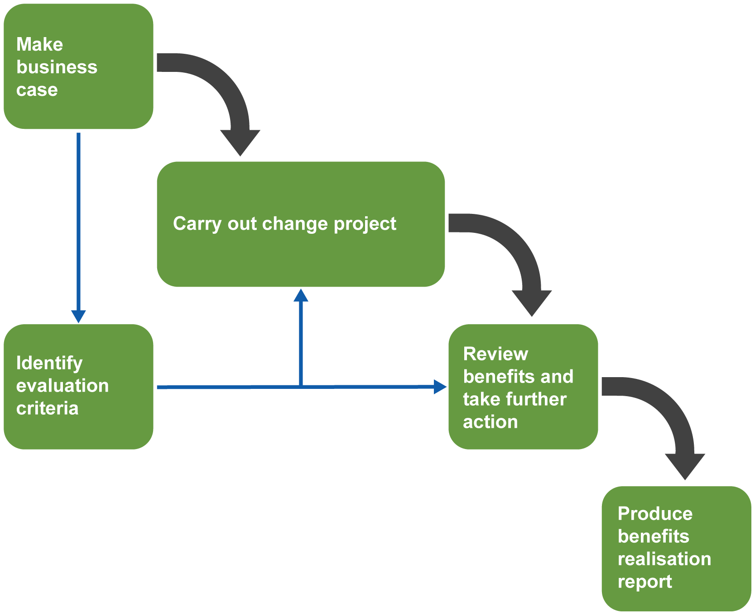
Benefits Realisation Approach
Notes:
Chapter 14, pg 272
The above shows that the planning of the benefits realisation stage occurs early on in the project. As the project progresses the evaluation criteria will be identified and refined.
At the end of the project the benefits can be reviewed and actioned. At a later stage the benefits realisation report should be written and published. This may not occur until the change is well established in BaU, perhaps even years after implementation.

Slide 201
Involvement in the Realisation Stage
Well defined, planned and manageable benefits
Three distinct areas:
Benefits Plan
Business Case
Benefits Reviews
Notes:
Pg 270 – 273

Slide 202
Realisation Stage: Benefits Plan
Benefits plan
Context/Vision
Benefits profiles
Benefit owner
Responsibilities for measurement and achieving the benefit
‘Benefits dependency network’
Diagram for what needs to be done
Responsibilities
Tracking of benefits
Notes:
Pg 270 - 272
Benefits Dependency Network mentioned on pg 271
A benefits dependency network, which is an output from this step, helps to relate the IT functionality that will be required to the business and organisational changes which will eventually facilitate the benefit. It does this through a diagrammatic representation of the steps needed to achieve the goals. It considers IT Enablers, Enabling changes, business changes the benefits and the objectives.

Slide 203
Realisation Stage: Business Case
Central to the Business Change Lifecycle
Facilitates change controls and impact analysis
Reviews and continual checking against the investment
Notes:
Pg 272

Slide 204
Realisation Stage: Benefits Reviews
Scheduled reviews vs. unscheduled reviews
Benefits Realisation report
Has the change been successful?
Have we managed time, effort and cost effectively?
Provide input into future business cases
Facilitates future selection of projects
How are we doing?
How did we do?
Notes:
Pg 272 - 273
Scheduled reviews
Based on project decision gates
Can we still meet the forecasted benefits?
Is the investment sufficient?
Unscheduled reviews
Triggered by events during the project
Major change requests
Budget, stakeholder, strategic or resource changes
Benefits Realisation report
Has the change been successful?
Have we managed time, effort and cost effectively?
Provide input into future business cases
Facilitates future selection of projects

Slide 205
Putting it all together
The Business Analysis Process Model

Slide 206
INPUTS
STAGE
OUTPUTS
TECHNIQUES
Terms of reference/ PID
Business strategy and objectives
Business situation
Rich pics
List of issues/needs log
INVESTIGATE SITUATION
Investigation techniques (Quant. & Qual.)
Rich pics, mind maps etc
BUSINESS CONTEXT
TOR / PID
Business strategy and objectives
Stakeholder perspectives
BAM per s/holder
Consensus BAM
CONSIDER PERSPECTIVES
Investigation techniques
Stakeholder ID and analysis
CATWOE / BAM
BAM
View of AS-IS
Business strategy and objectives
Activity analysis
Gap analysis
AS-IS + TO-BE
List of improvements
ANALYSE NEEDS
Gap analysis
Activity analysis
Business process modelling
TOR / PID
Business strategy and objectives
List of improvements
Shortlisted options
Business Case
EVALUATE OPTIONS
Business options analysis
Cost/Benefit analysis
Impact / risk
Selected option
Business strategy and objectives
TOR/PID
To-Be process model
Organisation structure
Requirements document
DEFINE REQUIREMENTS
Business process modelling
Investigative techniques
Requirements engineering
IT systems modelling
Notes:
This is replicated at the back of the Revision Workbook…

Slide 207
Well Done!
Business Analysis Foundation Certificate course

